Slide 1

aws & devops internship
MAIN PROJECT -2

Slide 2
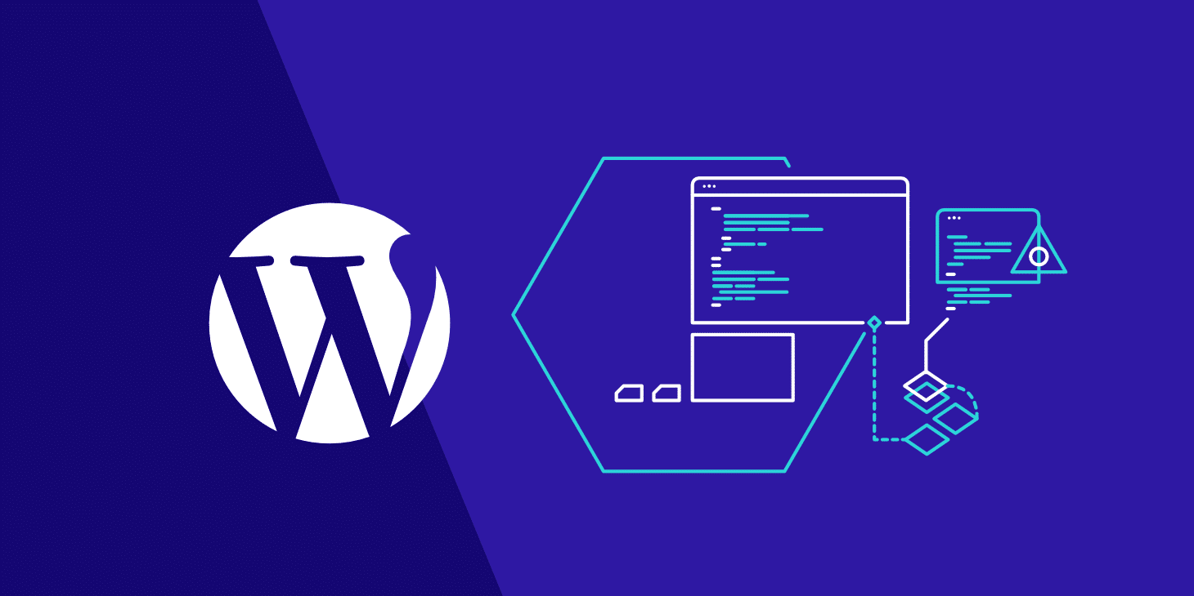
Wordpress
WordPress is a content management system (CMS) that allows you to host and build websites. WordPress contains plugin architecture and a template system, segment system you can customize any website to fit your business, blog, portfolio, or online store.
It's a popular tool for individuals without any coding experience
Anyone can install, use, and modify it for free

Slide 3
Wordpress working methods
Manually create and deploy the wordpress application?
Build and deploy wordpress application by using docker and Docker-compose file?
Build and deploy wordpress apllication by using user-data
Build and deploy wordpress application by using bashscript?
Build and deploy wordpress application by using Jenkins, Git and Github (create clone job and build job)
Build and deploy wordpress application by using Jenkins, Git, Github Bashscript?
Build and deploy wordpress application in pipeline method by using Jenkins, Git and Github (create clone job and build job) tools apply and apply build periodically. Poll scm and webhooks methods?
Build and deploy wordpress application Terraform (create entire no of vpc instances and data.sh and push Terraform code in Github)?
Build and deploy wordpress application by using Jenkins,Git, Github and Terraform ?
Build and deploy wordpress application by using user-data but host the wordpress on port 443?
Build and deploy wordpress application by using Docker. Docker-compose file and create the image push that created image into docker hub registry and host the image through K8’s (declarative manifest method)
Build and deploy wordpress application in pipeline method by using Jenkins, Git, Github and Terraform (create clone job and build job0 tools and apply build periodically. Poll scm and webhooks methods?

Slide 4
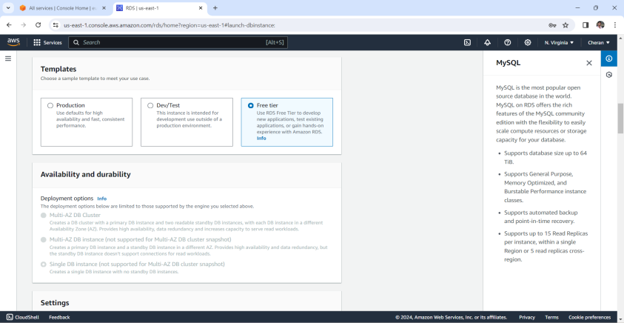
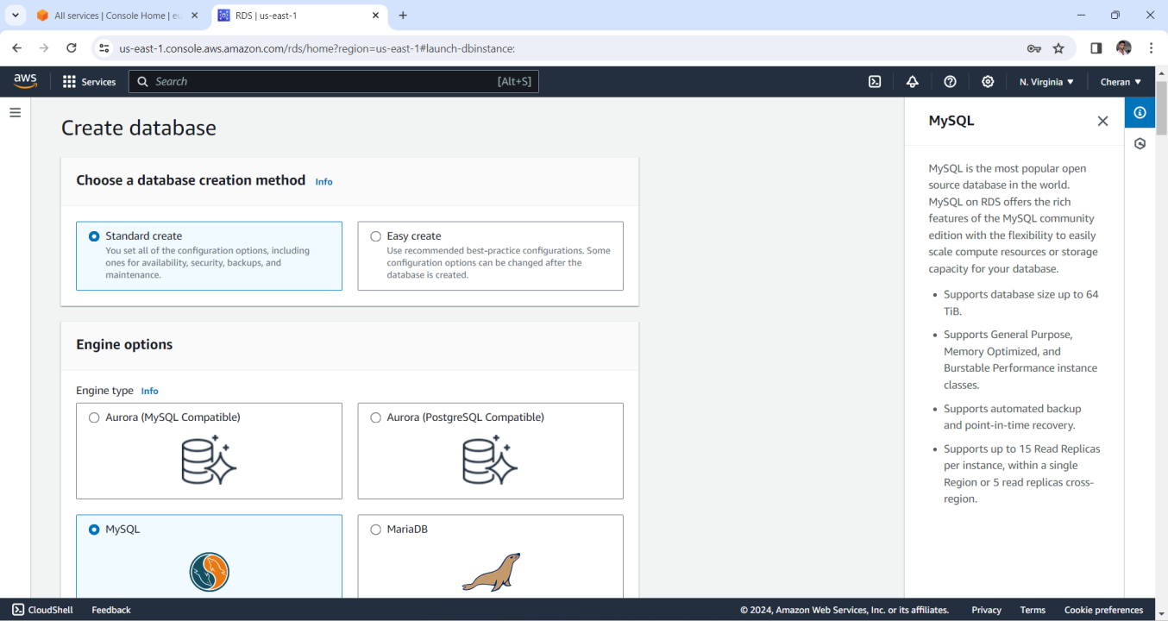
Method -1 Deploy wordpress with amazon rds
. First we goto amazon AWS console and login with account credentials
. After login with amazon console next go to RDS services and click on it
. Create a database with choose engine method which we want work on it
Notes:
-select a template for free tier which we are using only for practice purpose

Slide 5
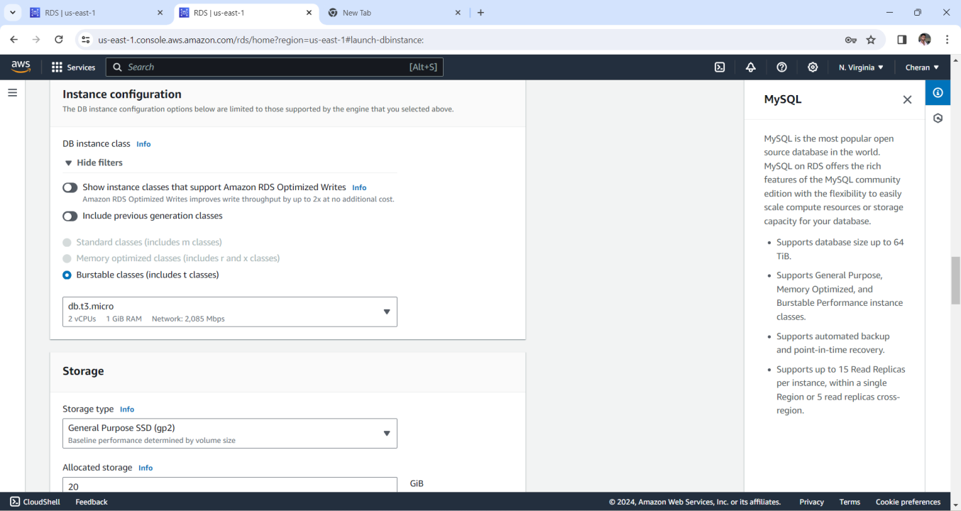
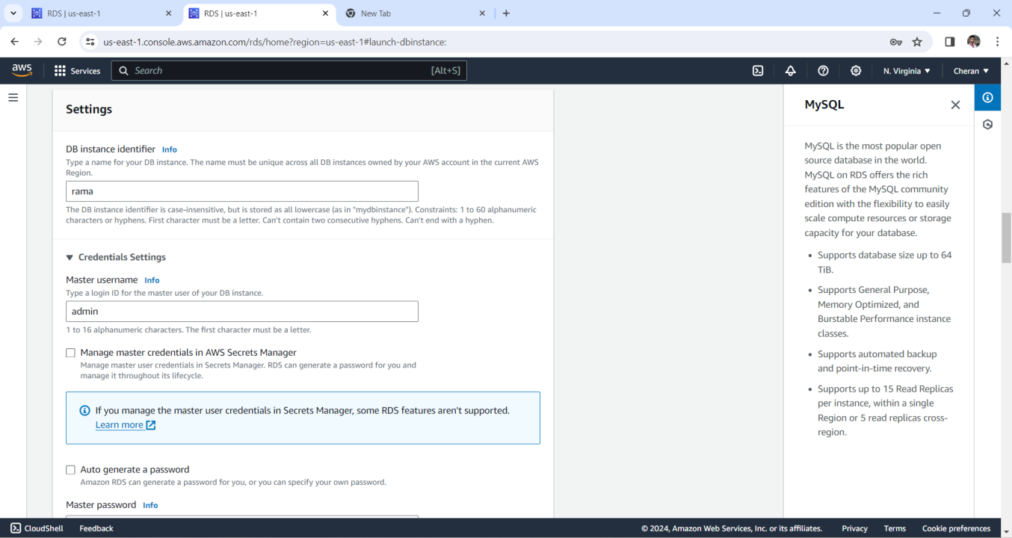
We are giving storage and allocated storage by default it given 20 GB if we want change it as we needed next we are giving instance name and credential username & master password

Slide 6
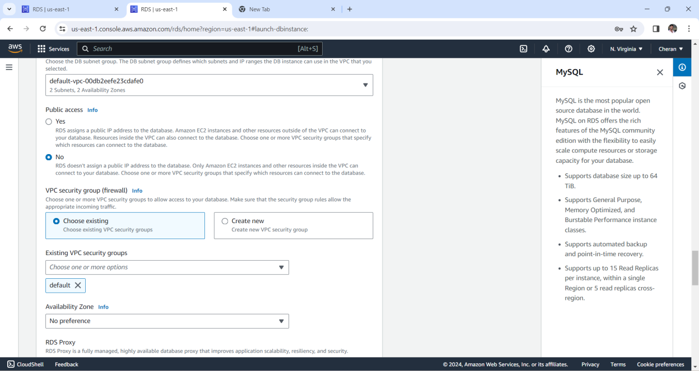
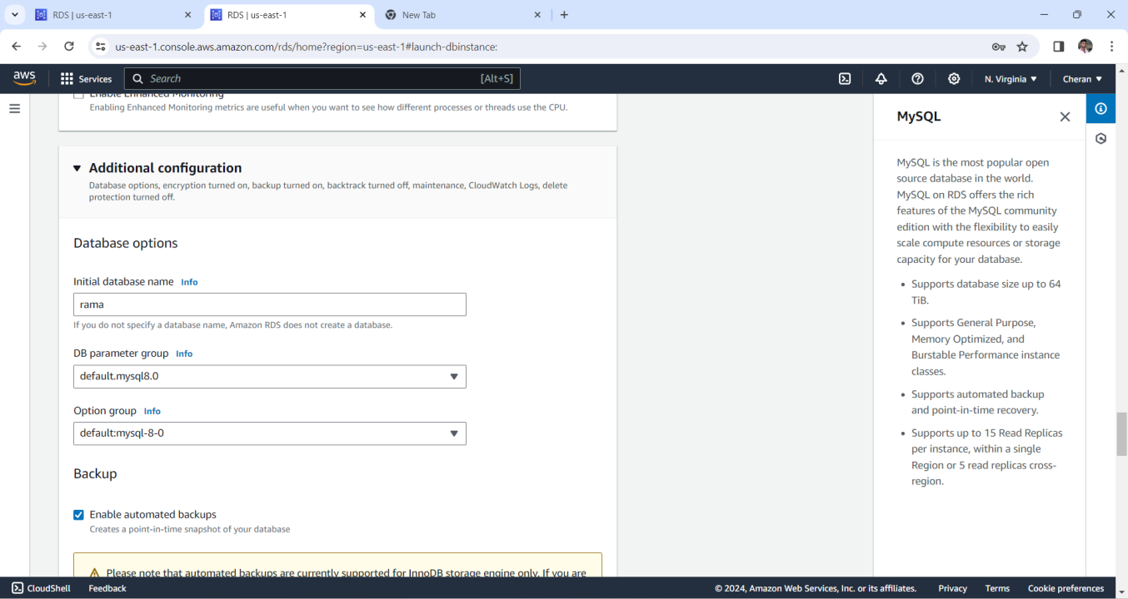
Notes:
.we are giving vpc security groups and availability zone
. We are giving identifier name also in additional configuration and enabled automated backups

Slide 7
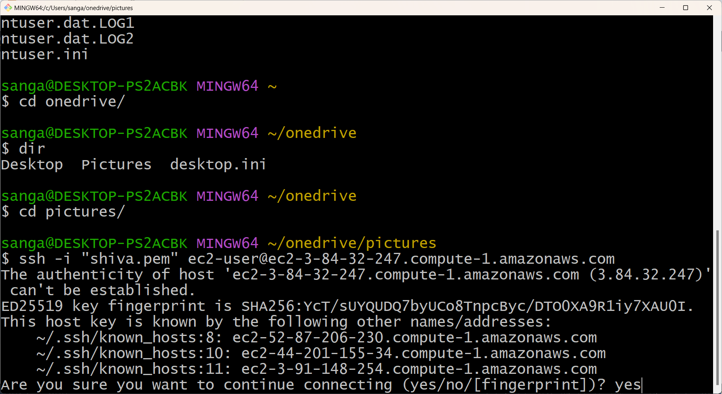
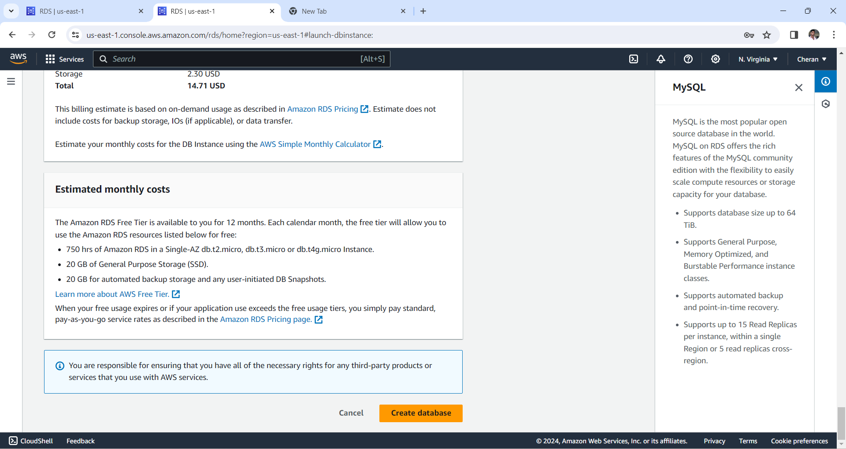
. when we launch create database it will take nearly 15 to 20 minutes
. After creating database we connect it any one terminal for linux we have GITBASH,GNOME terminal, TILIX and KONSOLE
.. I connected it with GITBASH and give the access to the terminal

Slide 8
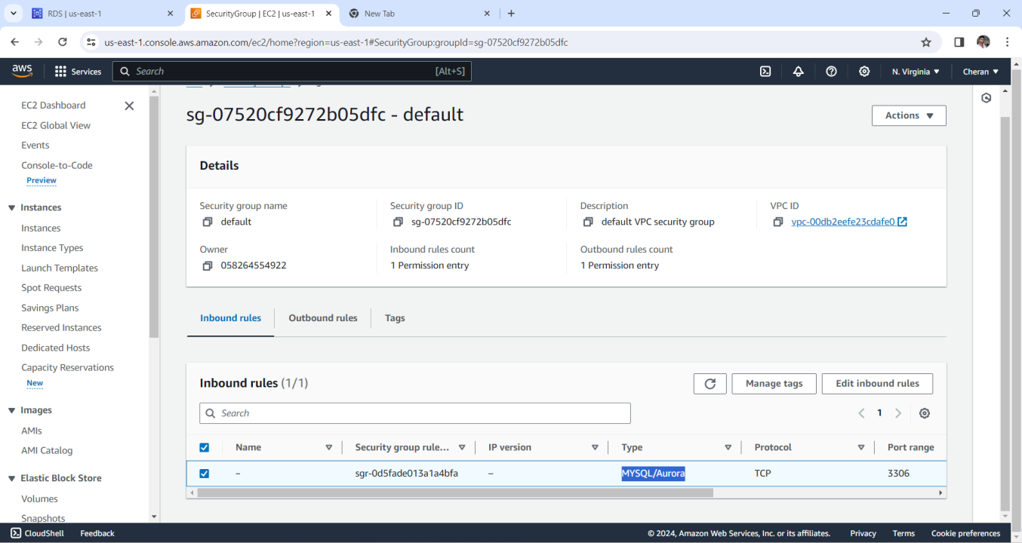
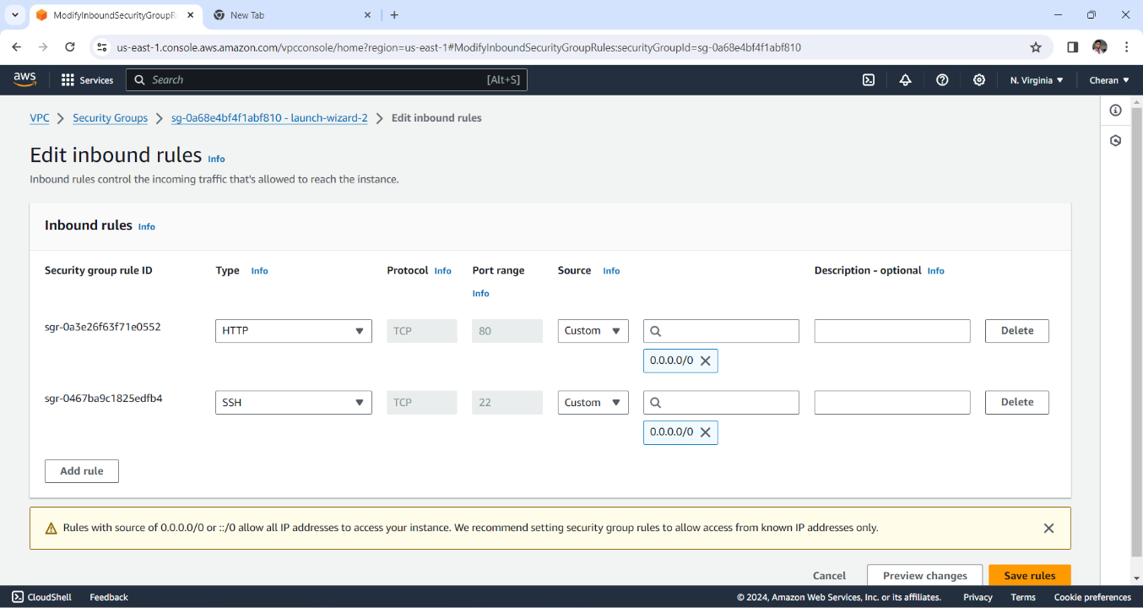
Before going to to install MYSQL first we go to security groups in RDS database change the inbound rules click on it after change the inbound rules next save rules
.we also given the port numbers SSH as 22 & HTTP as 80 and give security group type as MYSQL/AURORA automatically it will take port range 3306
.

Slide 9
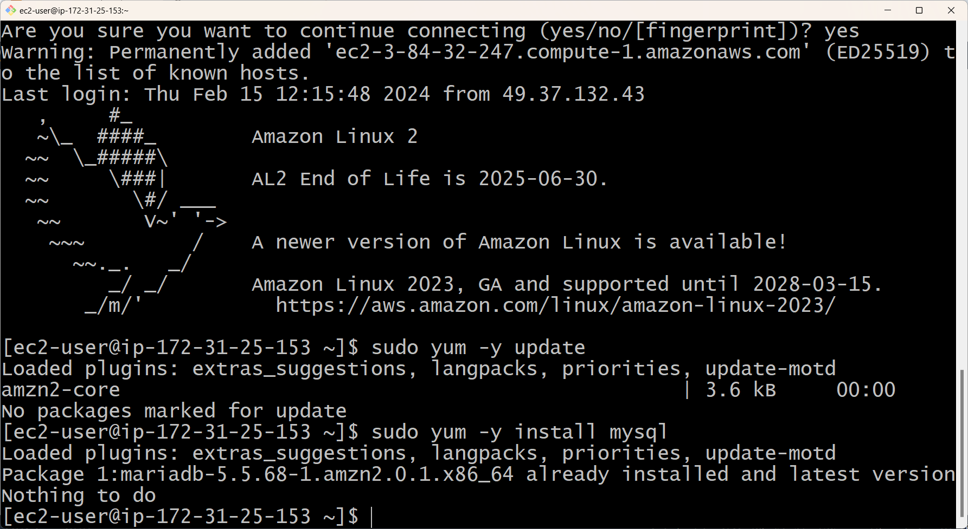
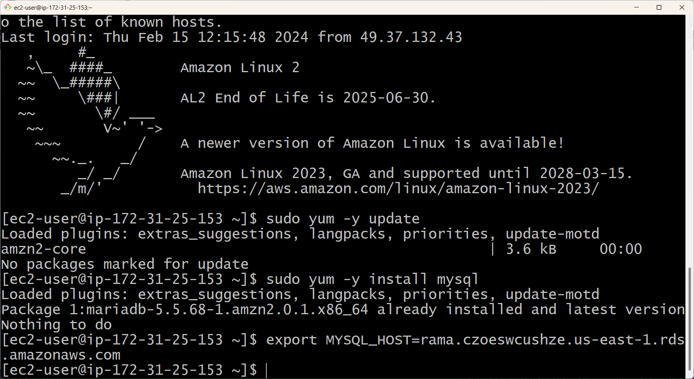
.Now we need to give root permissions and update it with using command SUDO YUM –Y UPDATE .Next we install mysql with command SUDO YUM -Y INSTALL MYSQL . After giving mqsql command next we give command export MYSQL_HOST=<end point address> after execution this command next give the command .”mysql user=<username>password=<password>database name” here is another command to commit our database access “mysql –h <endpoint> -u <user> -p”

Slide 10
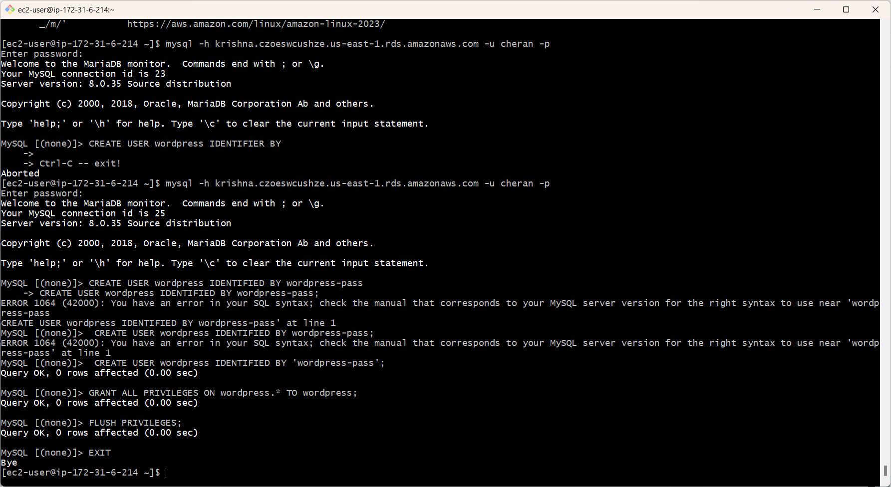
Now create a DB user for giving wordpress application permissions to access “wordpress” database .CREATE USER ‘wordpress’ IDENTIFIED BY ‘wordpress-pass’ GRANT ALL PREVILIGES ON wordpress.* TO wordpress;.FLUSH PRIVILIGES; .EXIT

Slide 11
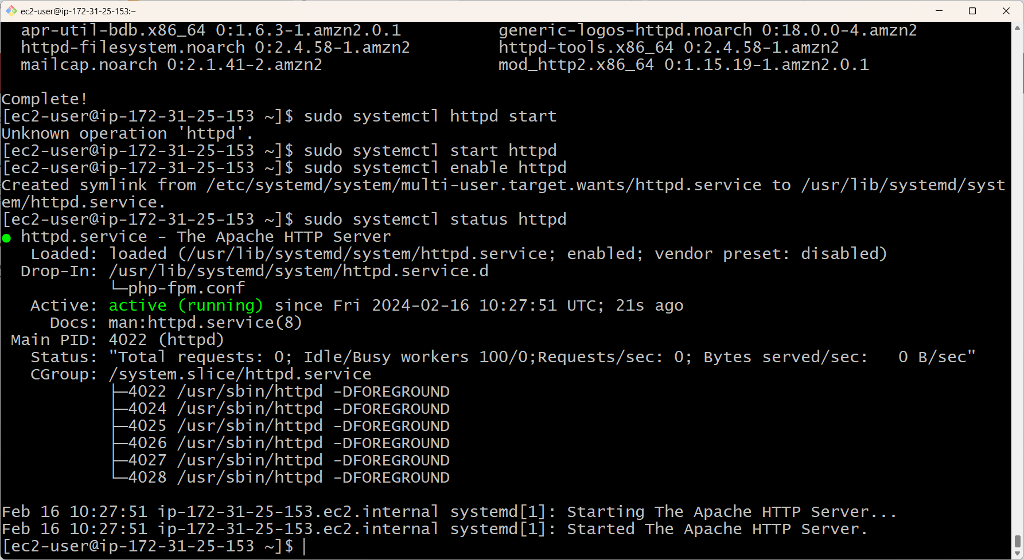
- next we use to host apache webserver we install some httpd servers like . “sudo systemctl start httpd” OR “sudo yum –y install httpd” - “sudo systemctl enable httpd” (or) “sudo ckckconfig httpd on” - Next we enable it with command “sudo systemctl enable httpd”

Slide 12
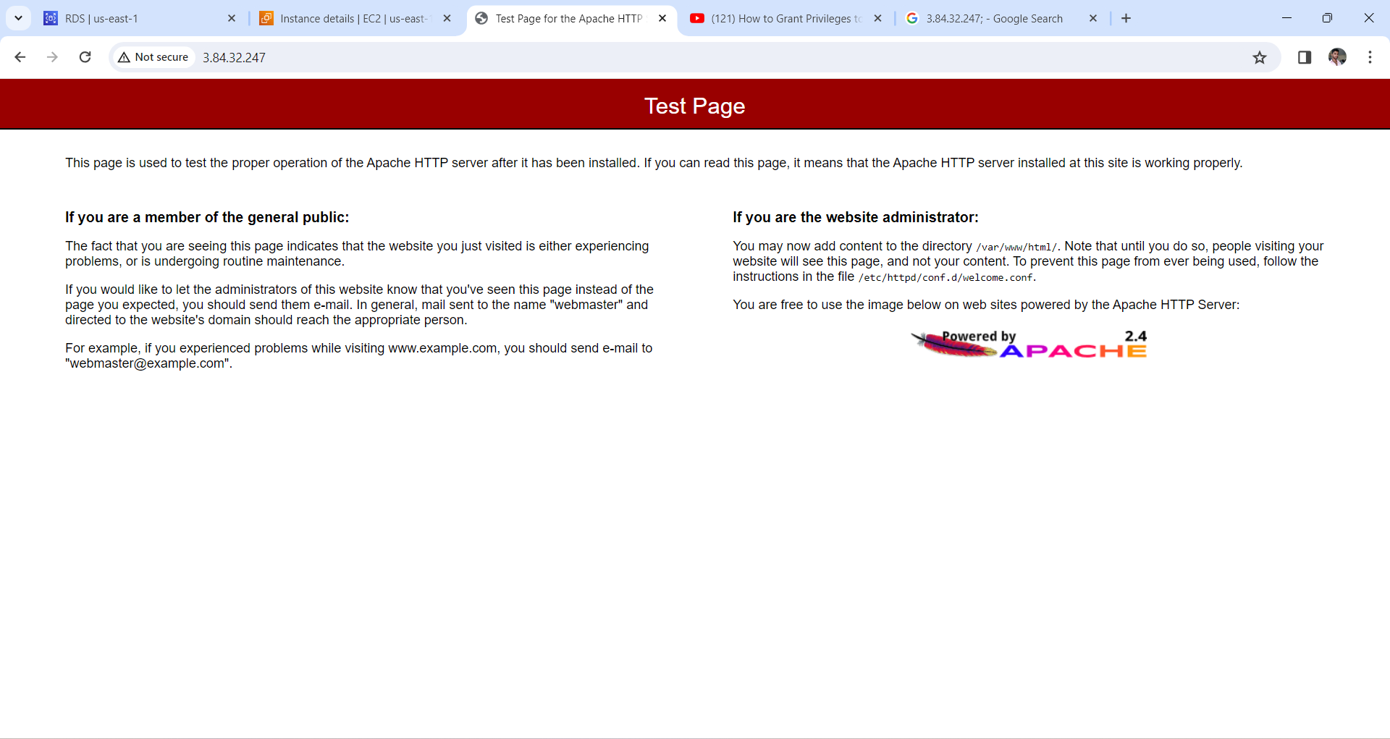
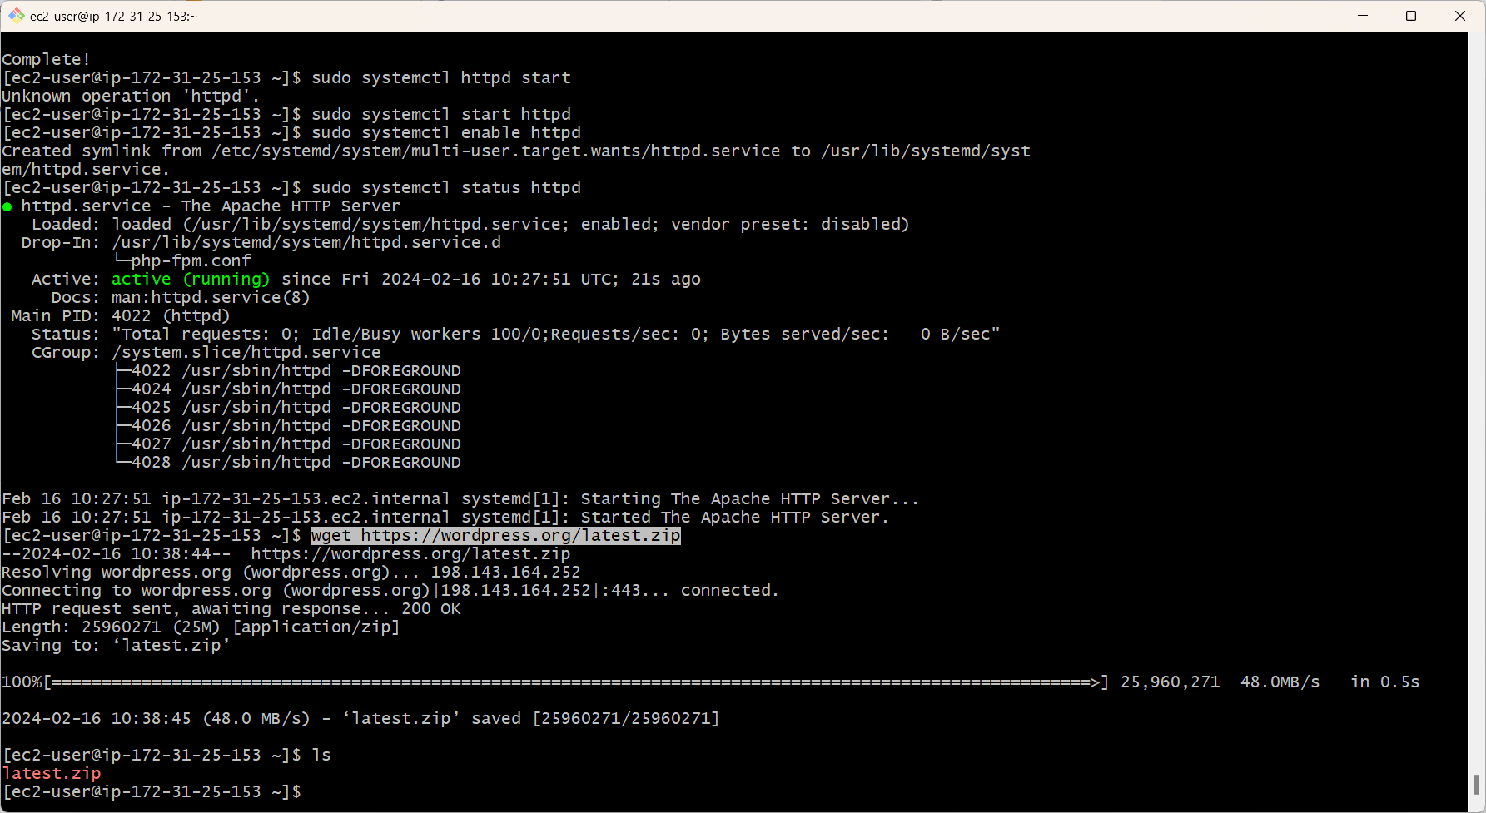
After completion of httpd server goto to the instance and copy the public ip of an instance which we connected it and browse it in the web server
.we see the test page of the APACHE
.To download wordpress installation package we using give the command “wget<address link of wordpress download file>”.
.using the command “cd<unzip directory>” change the wordpress configuration file command is “sudo mv wp-config-sample.php wp-config.php”

Slide 13
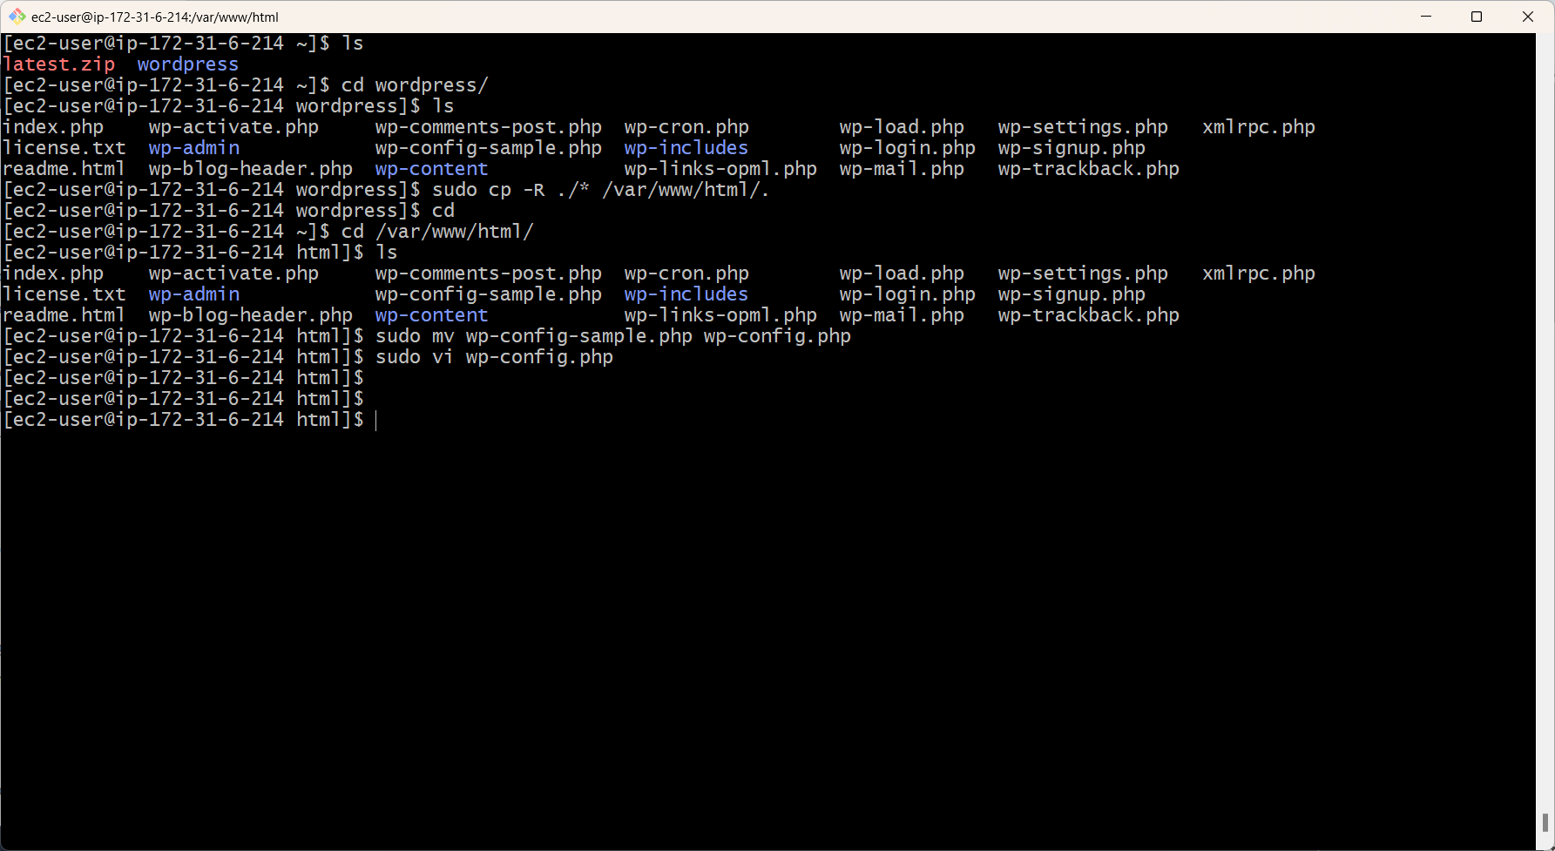
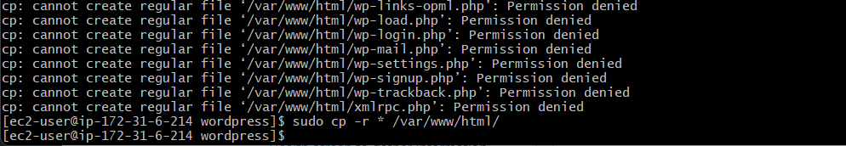
Below command copy files from A) "Sudo Cp-r <Unzip File Or Wordpress Directory>/* /Var/Www/Html/“

Slide 14
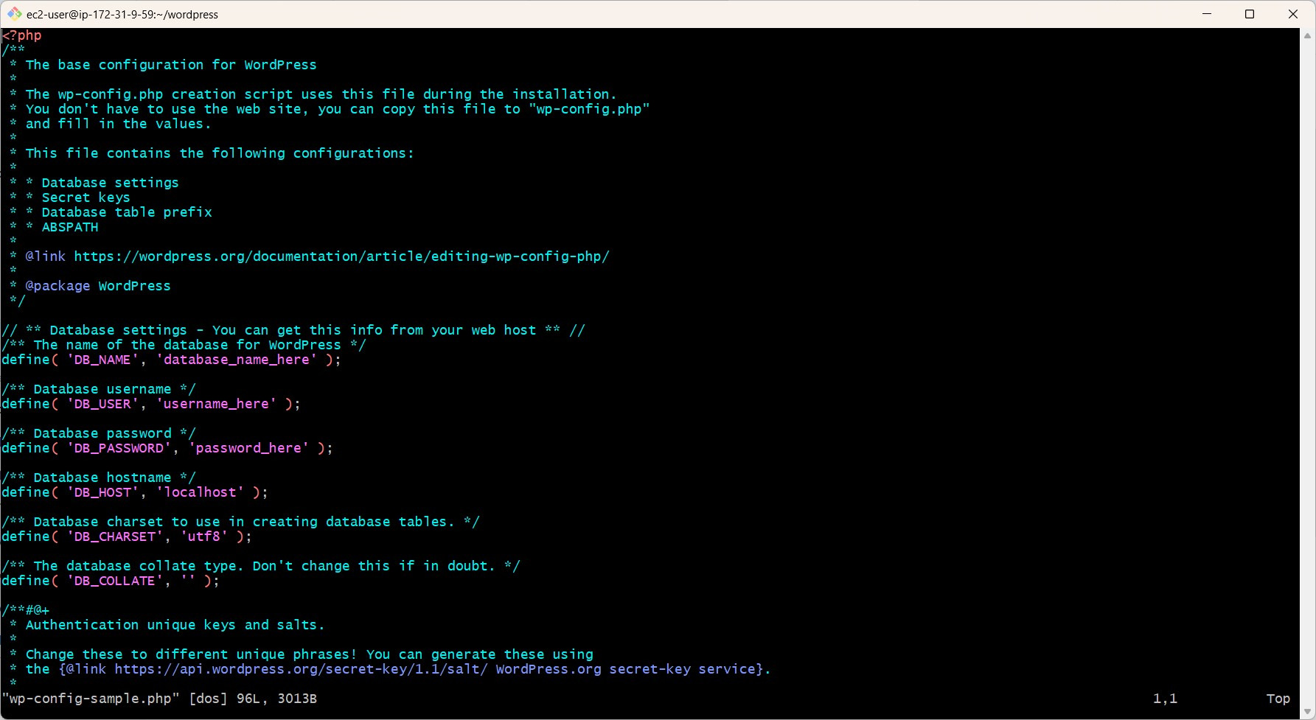
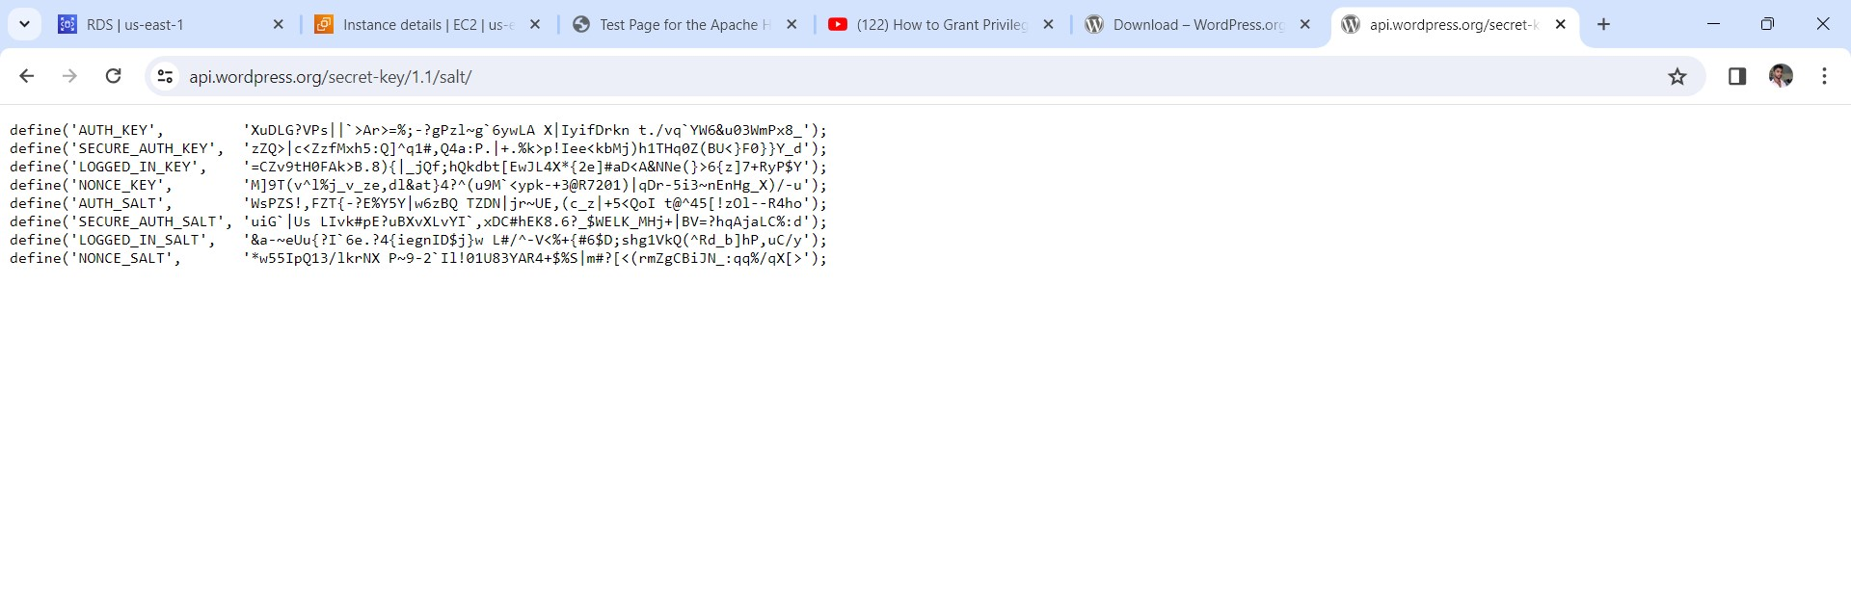

Slide 15
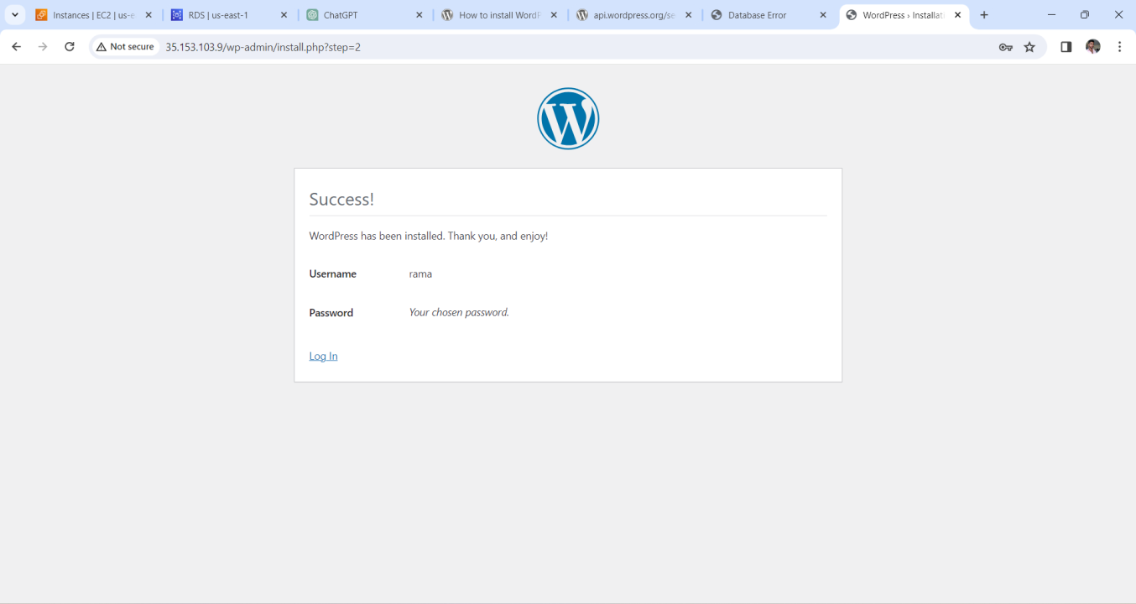
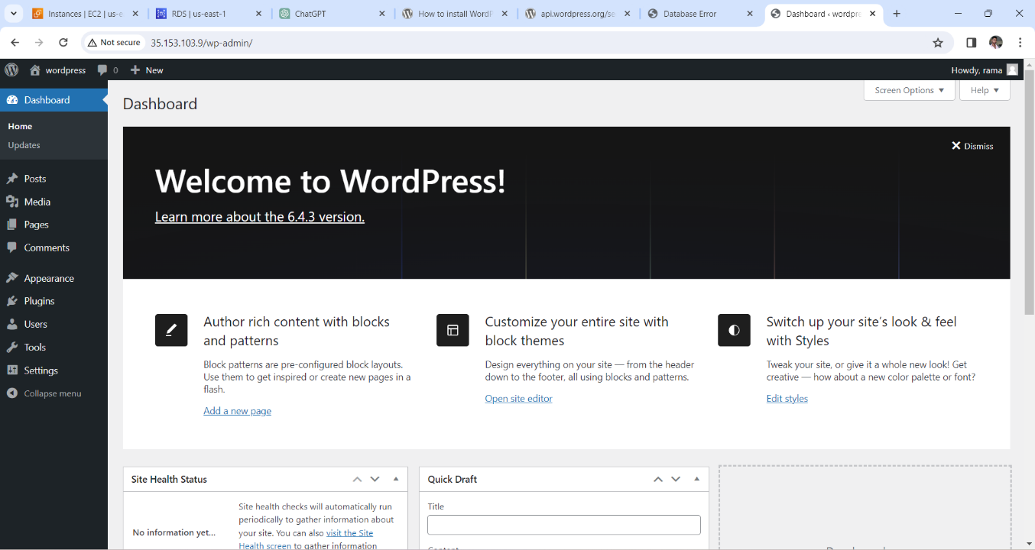
Now restart the httpd server server using command “sudo systemctl restart httpd” After restart httpd server now browse the public ip of the instance it will open and shows welcome to wordpress

Slide 16
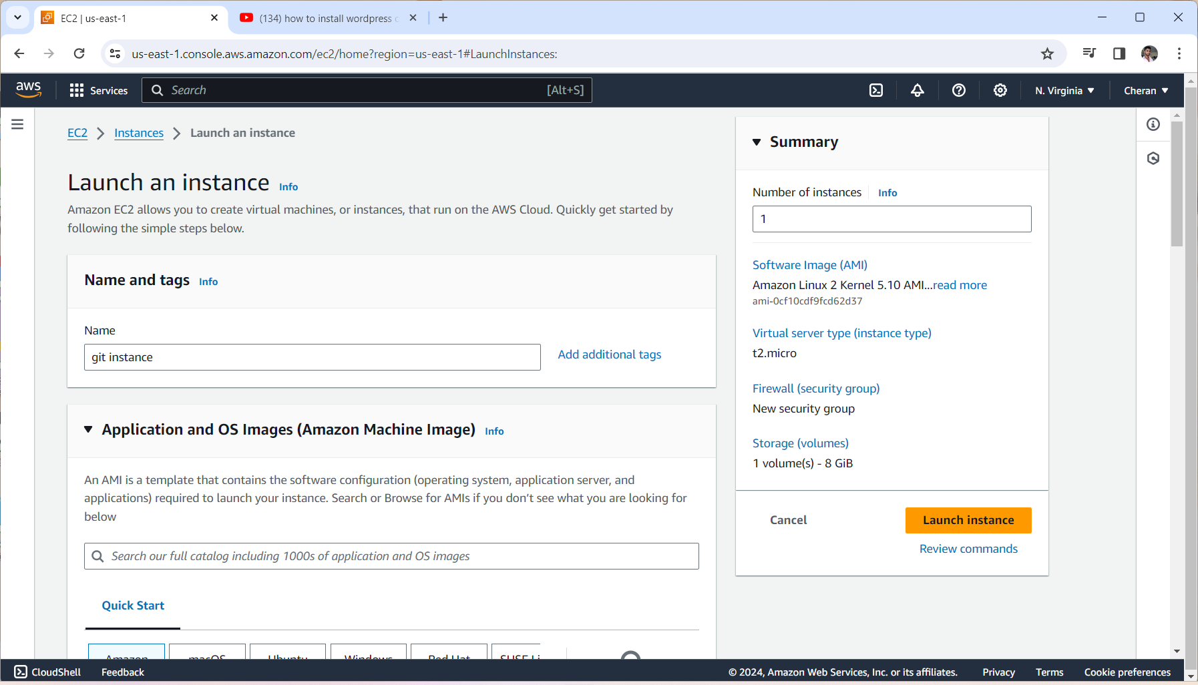
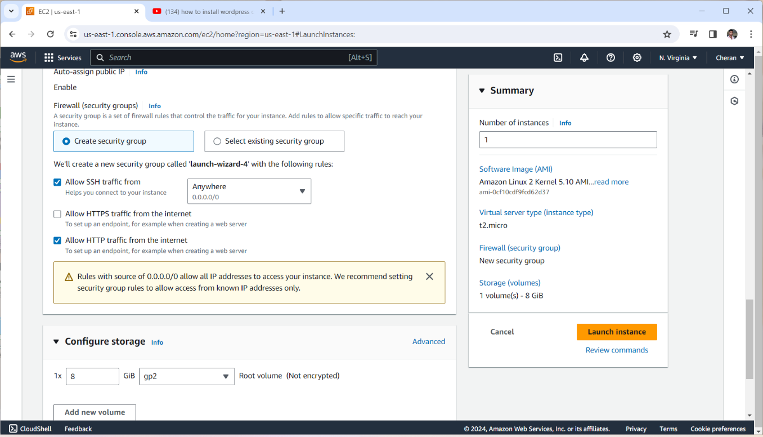
METHOD 2 BUILD AND DEPLOY WORDPRESS APPLICATION WITH DOCKER
We launch an instance with the Select community as Amazon linux
We taken instance type as t2.micro and give a keypair as existing keypair (or) newly created keypair and give the configuration storage
Given an ec2 instance with port numbers are 22 and 80 in anywhere.

Slide 17
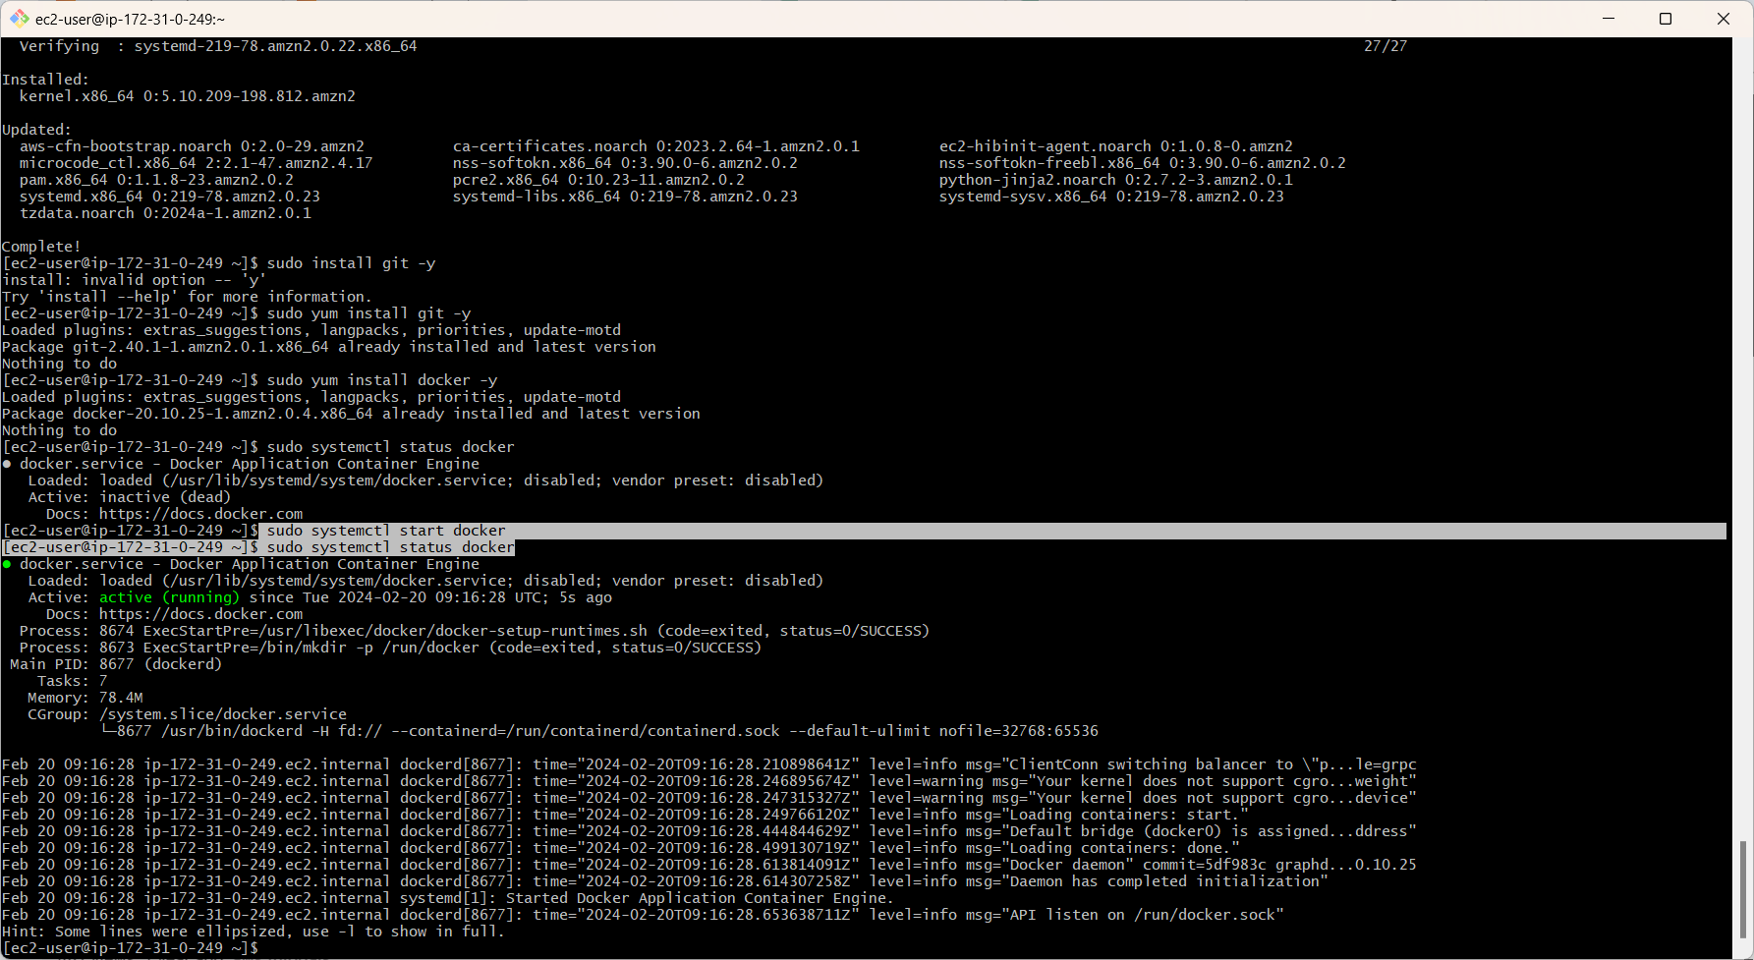
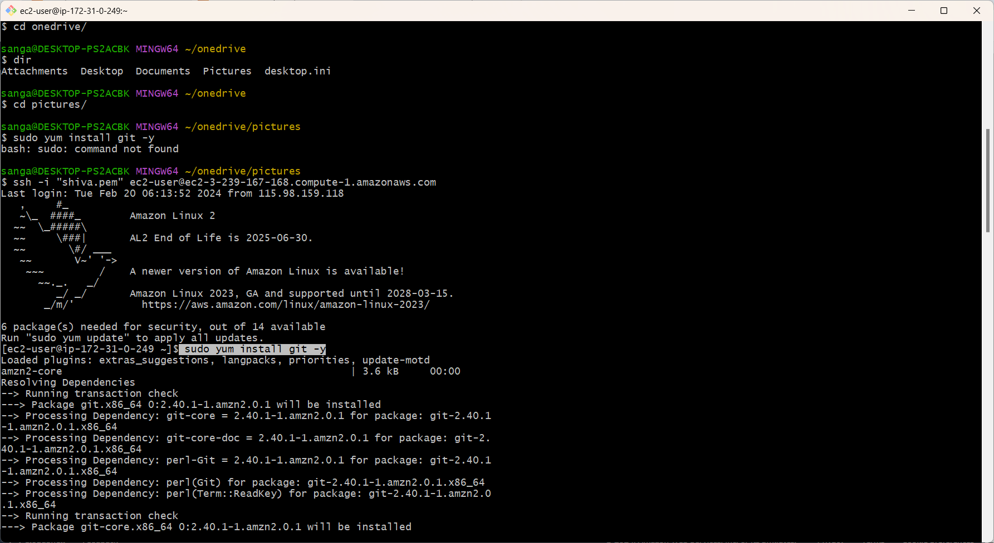
After connected the ec2 instance with anyone terminal we need to install some commands for running Git and Docker in the terminal
Here the commands are to install git sudo yum install git –y
. to install install docker sudo yum install docker –y after installation the git and docker we give commands to run it
to start docker with command sudo systemctl start docker it shows the status active running

Slide 18
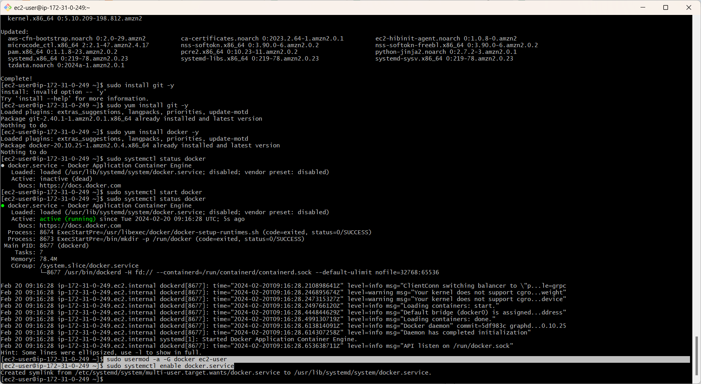
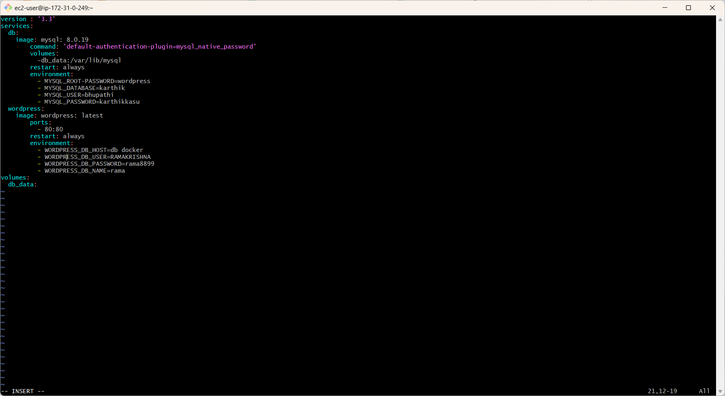
Give the permissions to the binary by using the command <sudo chmod +x /usr/local/bin/docker-compose>.
Then create a docker compose file <sudo vi docker-cmpose.yml> to pull the images from docker hub
Pull the images for mysql and WORDPRESS we use executed created docker compose file <docker-compose up –d>
after created the file we are give our mysql user, dbhost,and password and next attach created ec2
Notes:
After excuting docker compose file, next we

Slide 19
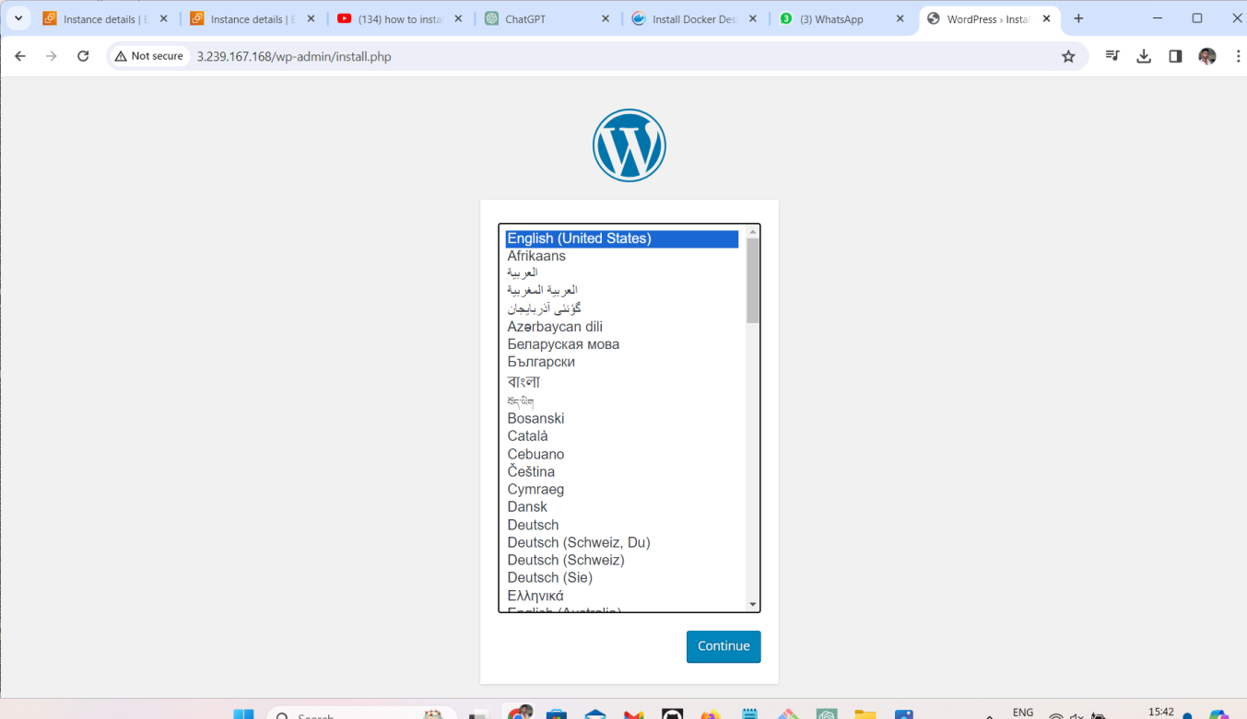
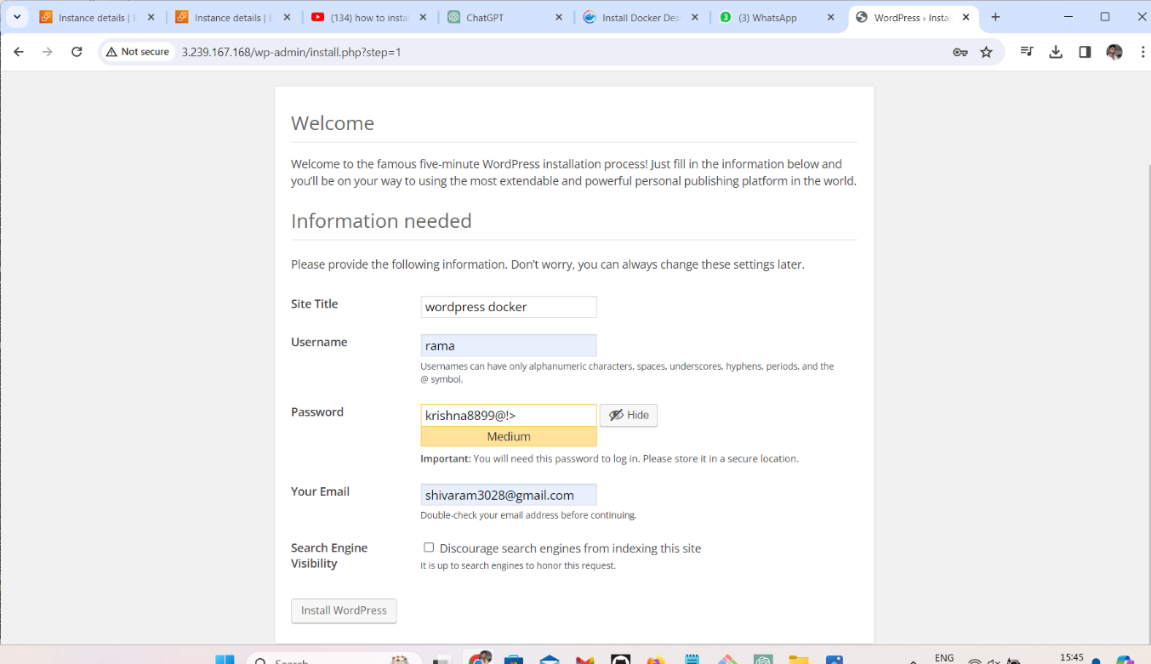
-Now browse the public ip in the server it executes install of wordpress
-After installation of wordpress we give some credentials to open wordpress after that we click on install wordpress it opens and it opens success.

Slide 20
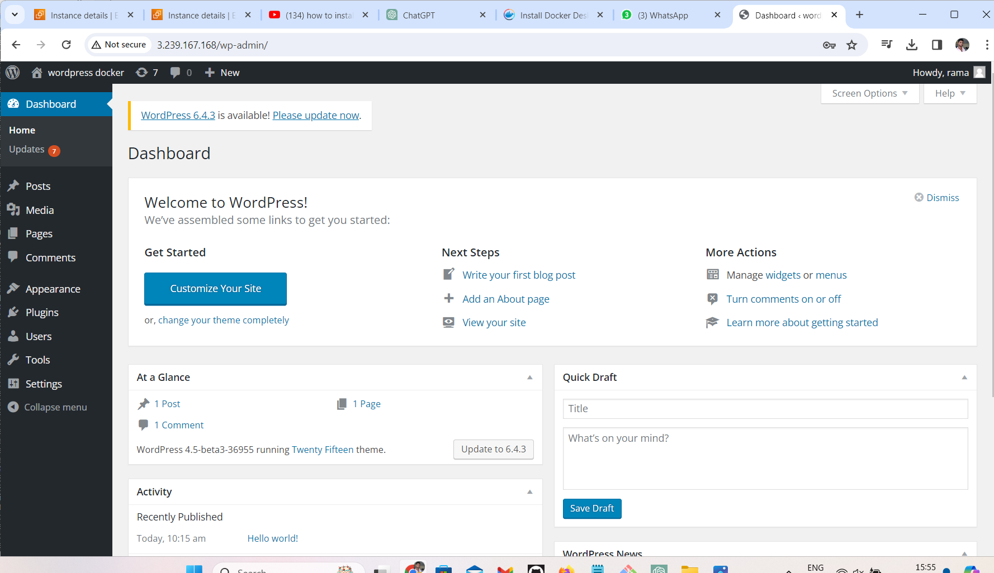
We are seen here wordpress open

Slide 21
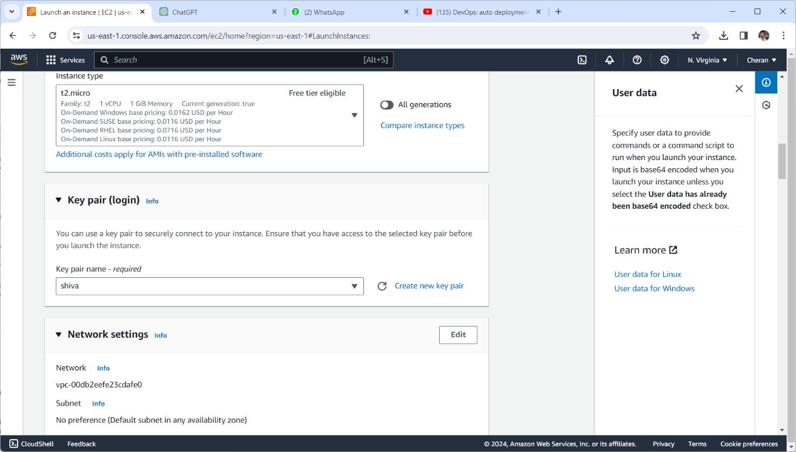
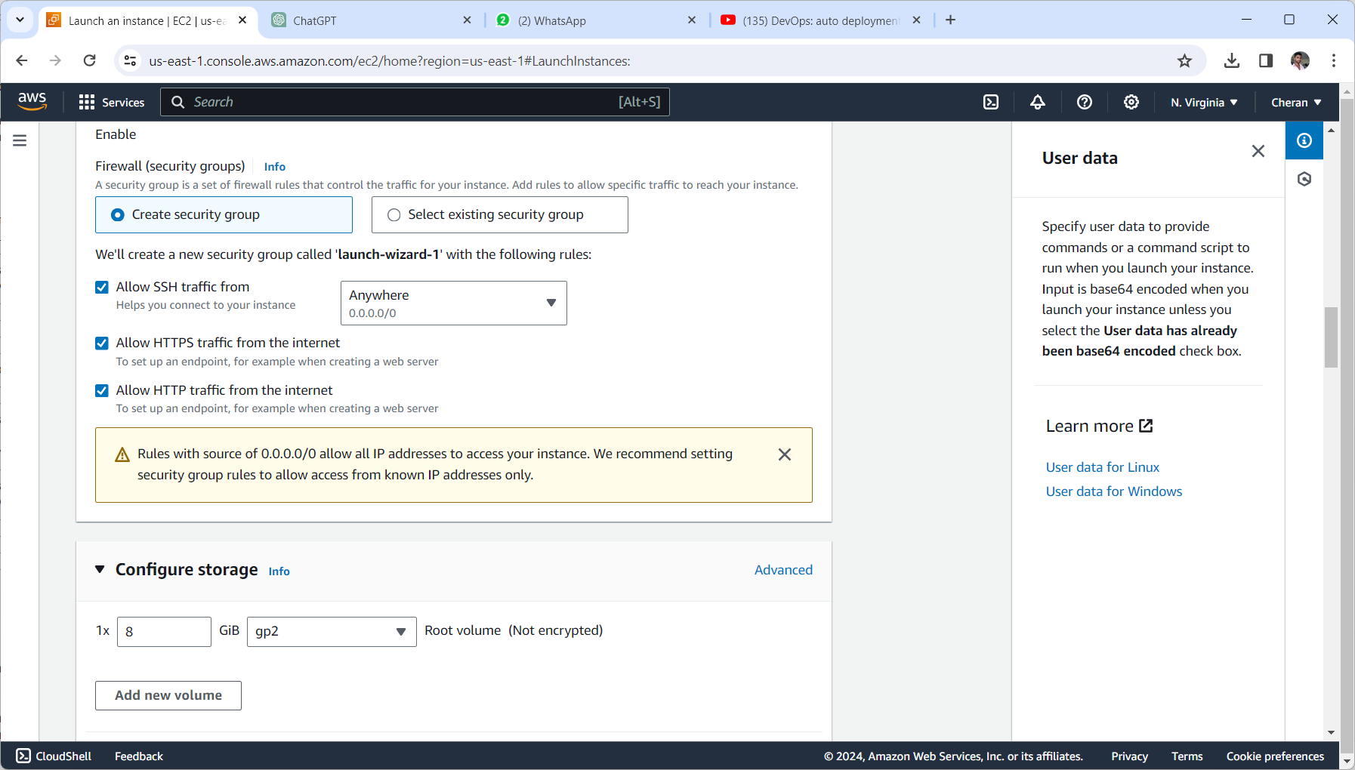
Method 3 build and deploy wordpress by using user-data

Slide 22
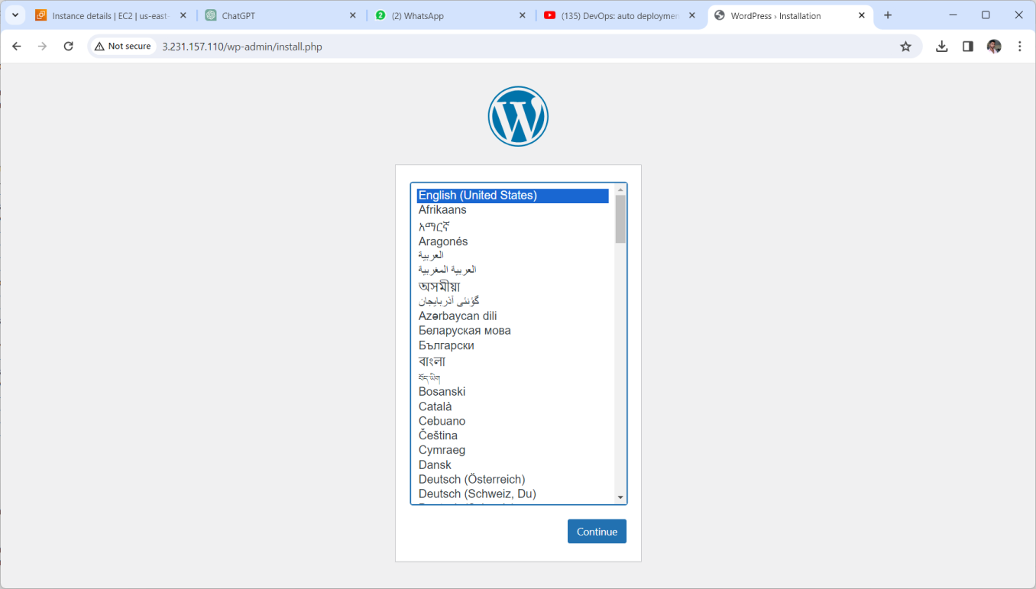
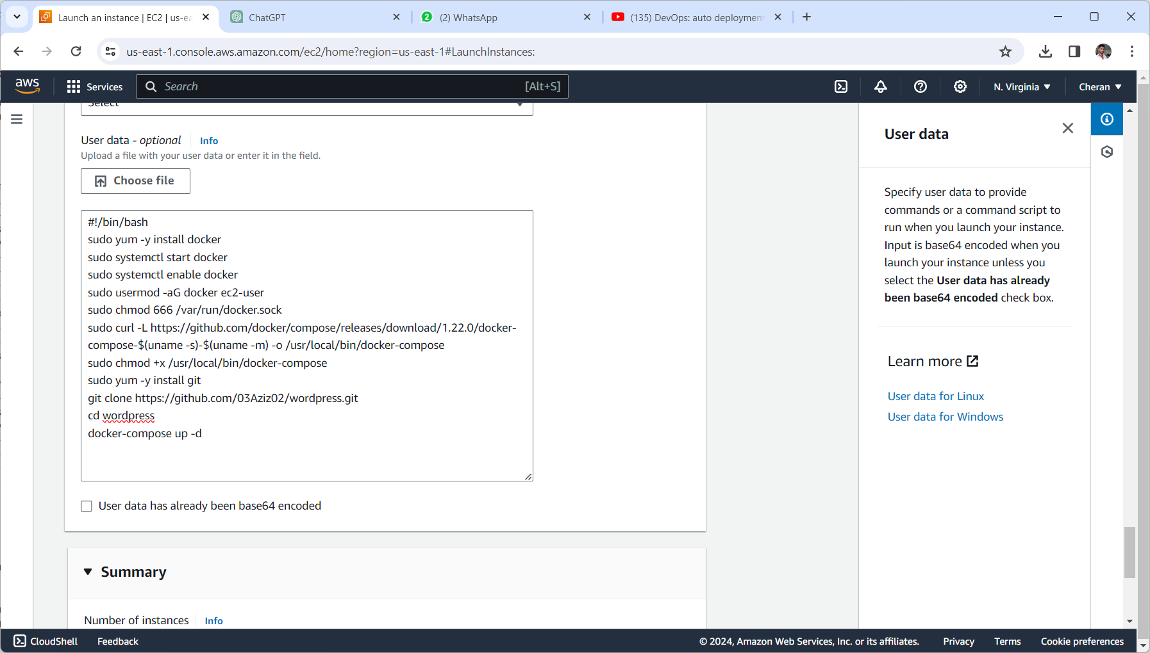
.Now we are given the userdata here in additonal settings user data in ec2 .instance next launch an instance after connected it with any one terminal .
After launching instance next browse the publip ip of an instance in browser
Next we seee the wordpress application start

Slide 23
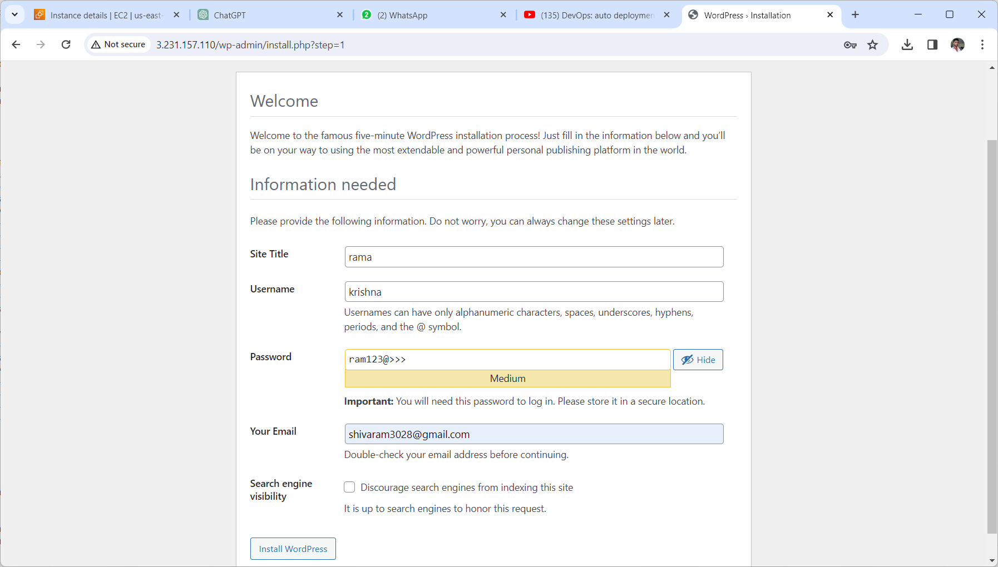
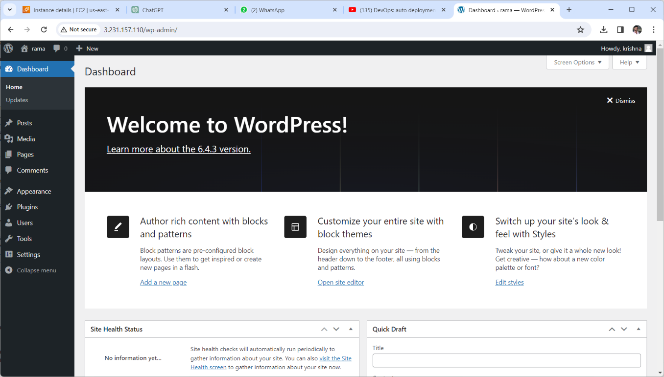
. Fill the given information page on wordpress we need to install wordpress
. After given credentials it will be routed to wordpress homepage

Slide 24
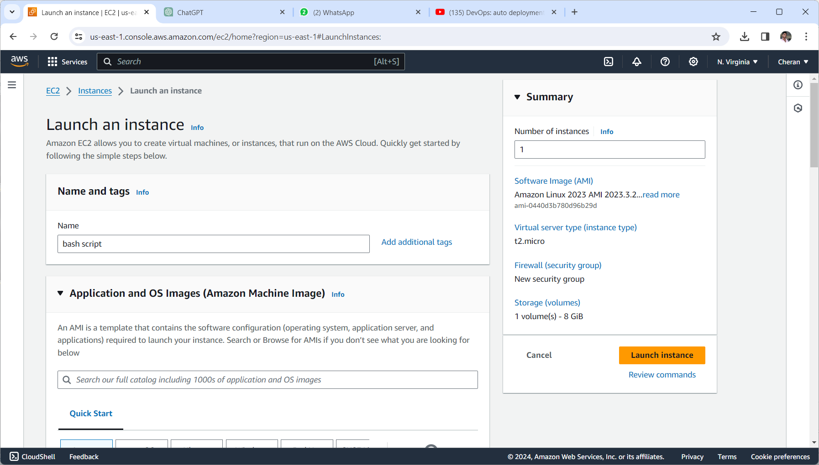
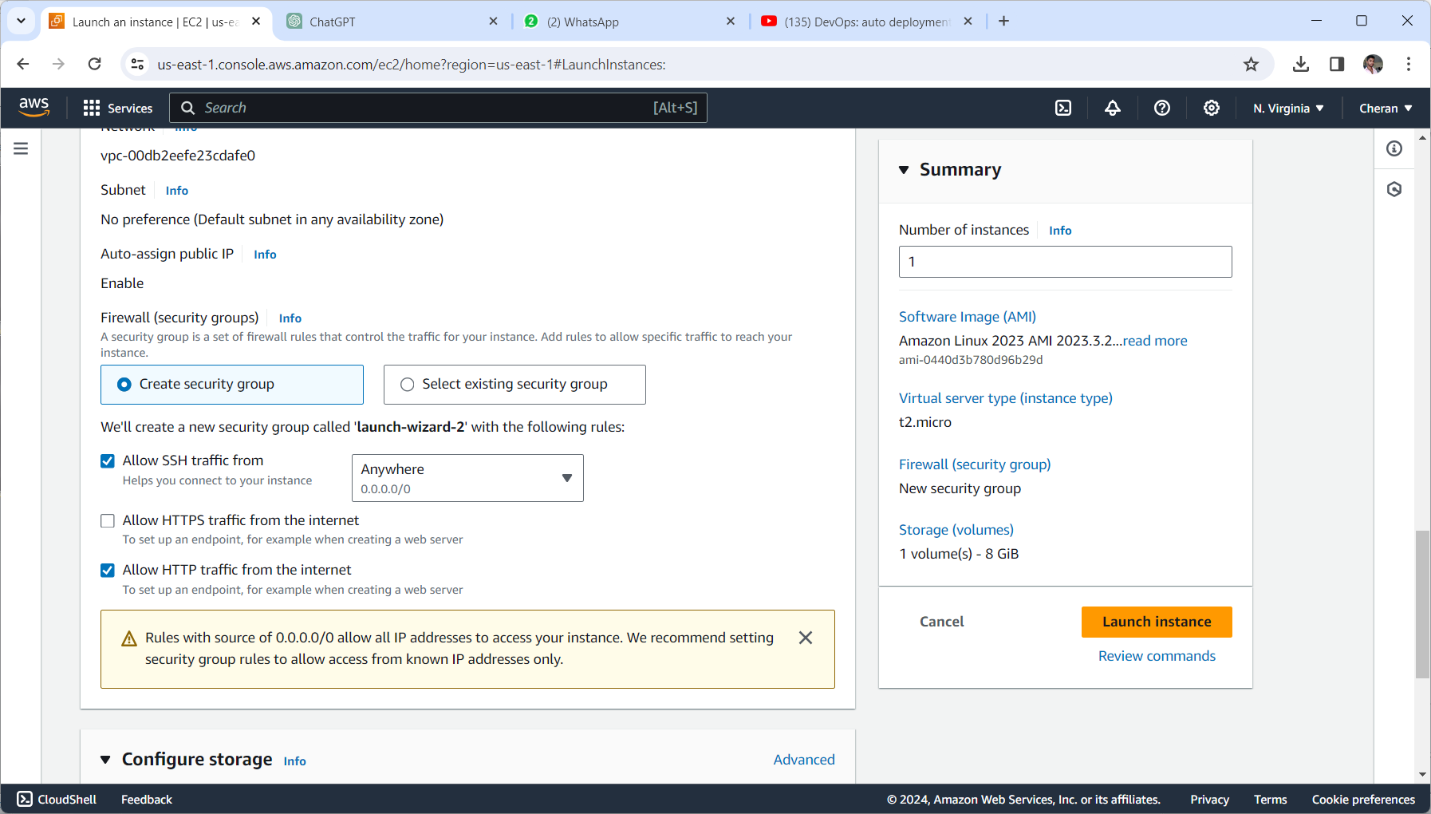
method 4 build and deploy wordpress application using bashscript
Launch an instance type with t2.micro with port numbers ssh 22 and http 80 in anywhere along with sg

Slide 25
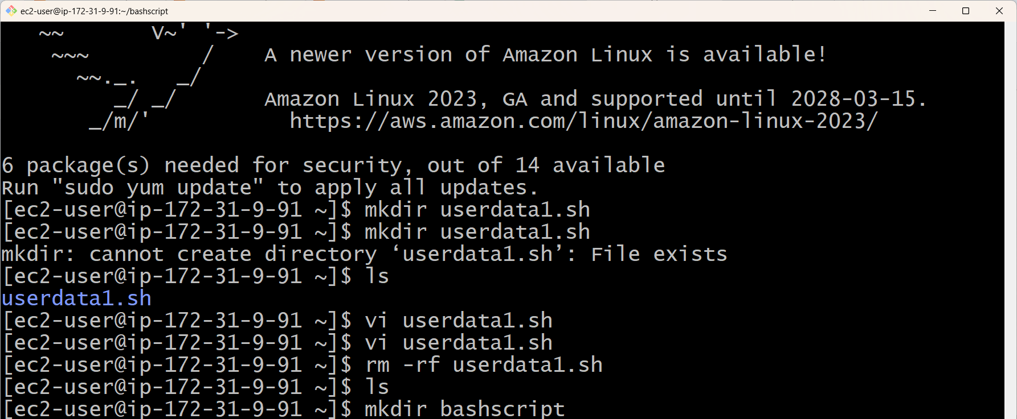
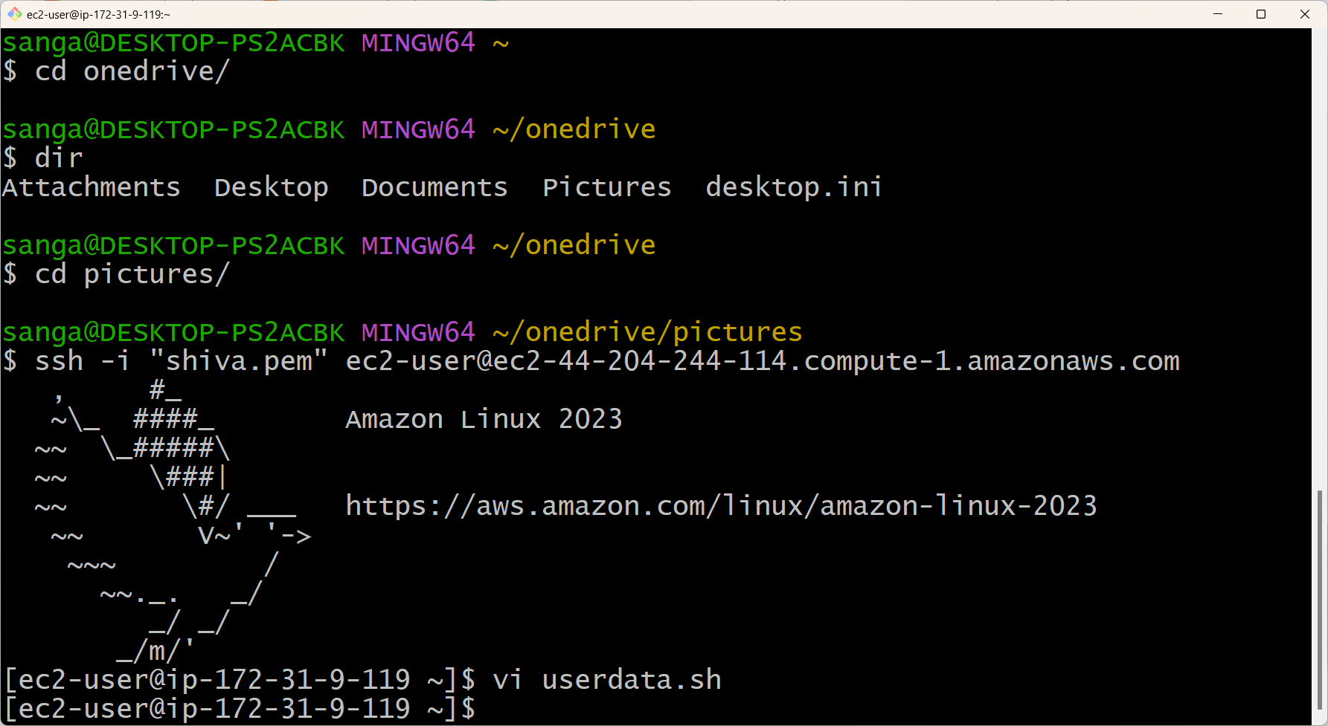
Connect the ec2 instance with copy ssh client and connect it with any one terminal
After connect it with gitbash terminal we giving some root permissions and given key yes to connect
Create a file userdata.sh in that file we write bashscript for deploy wordpress

Slide 26
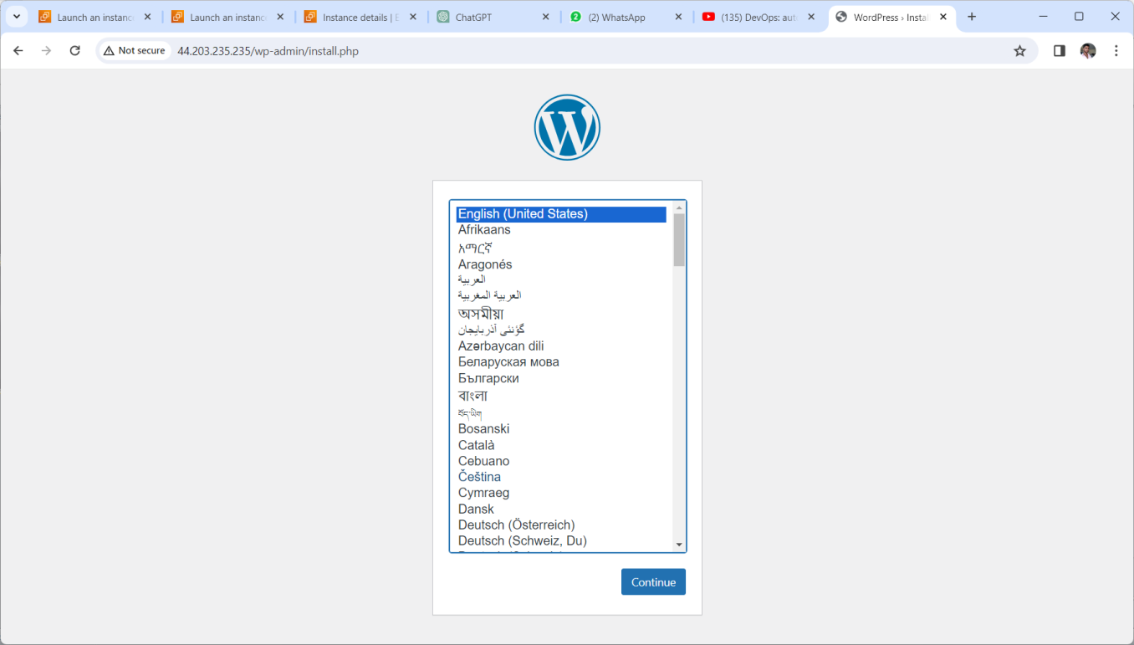
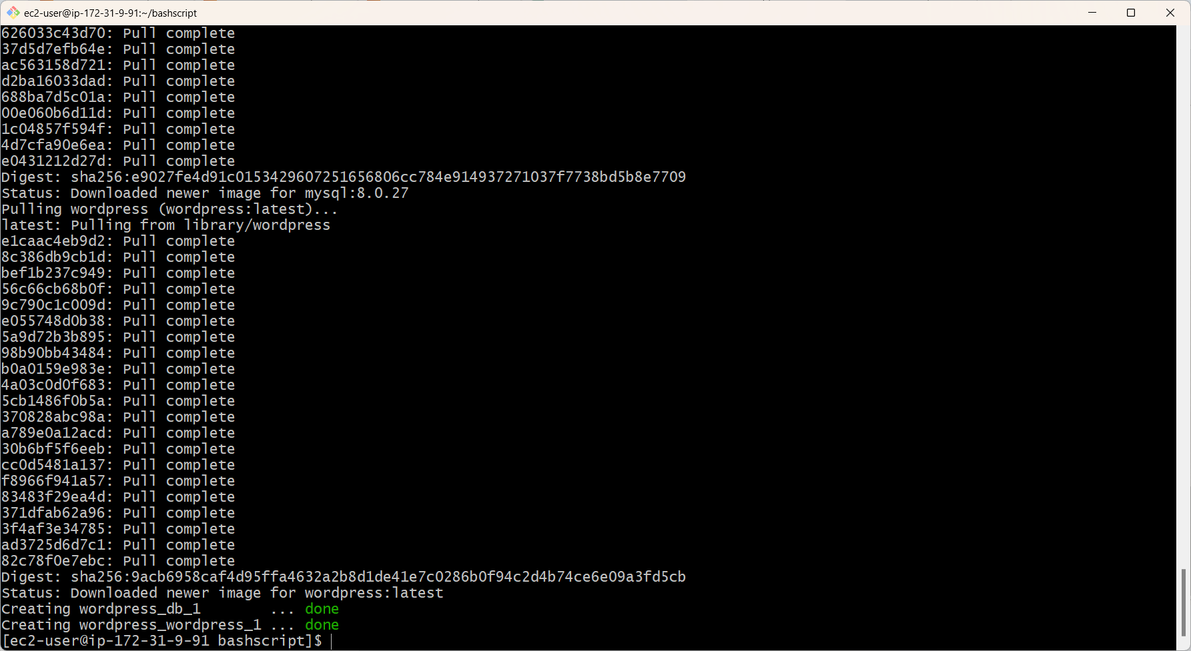
.“Sudo chmod +xdata.sh” this command modifies the script to execution
.we see here the wordpress is in creating state and completion done.
.copy the public ip of an instance and browse it in the browser the wordpress installation is starts

Slide 27

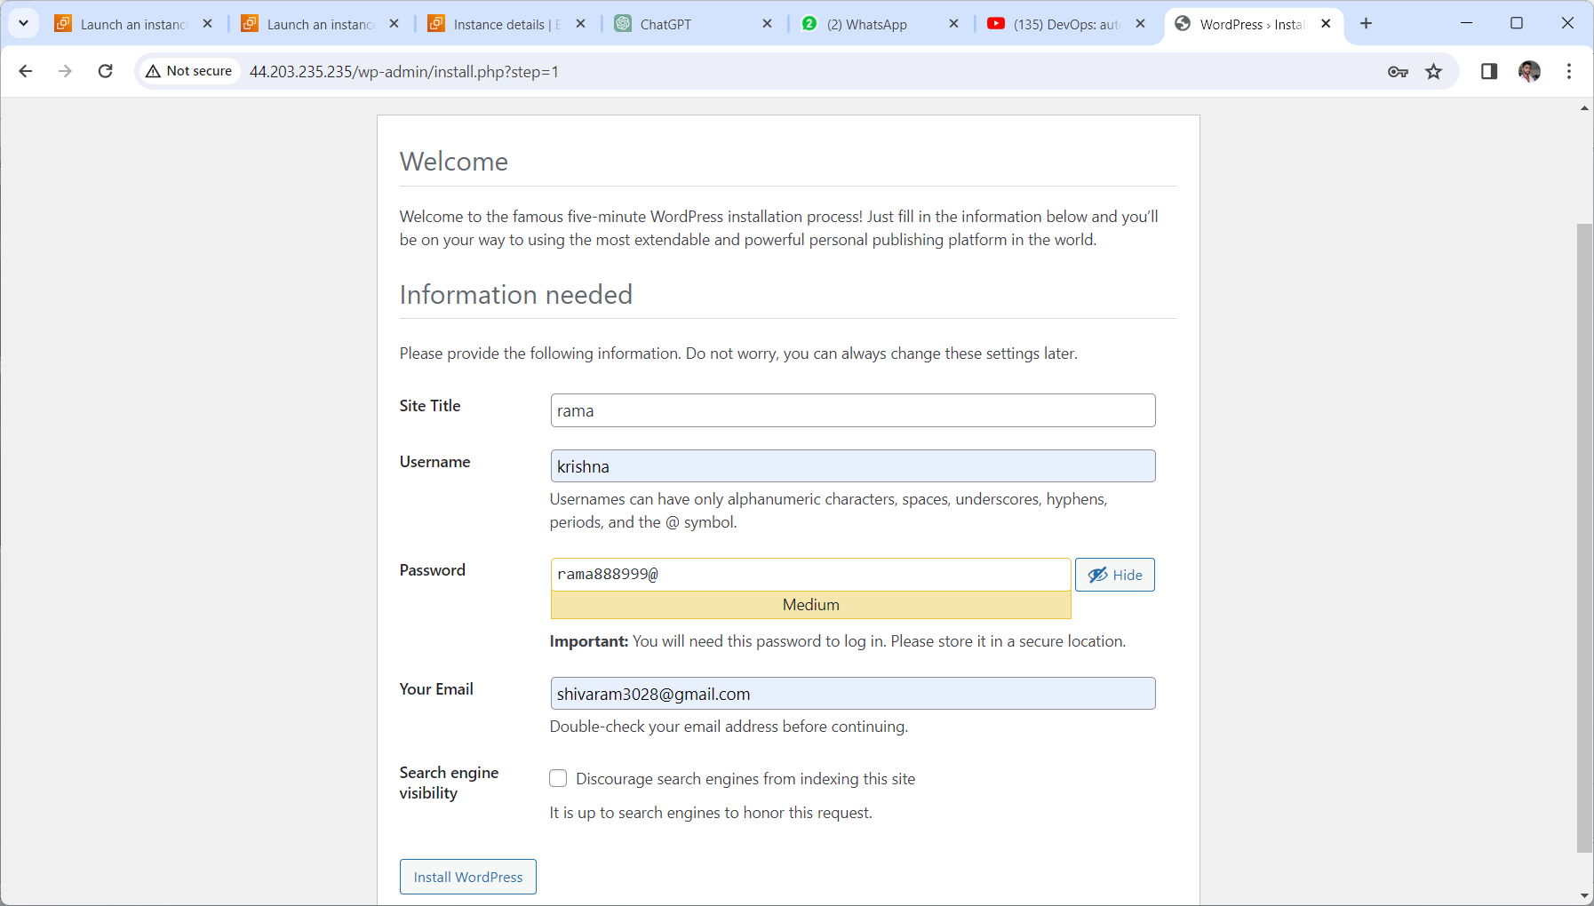
.Given the information for login and launch install wordpress
.after install wordpress you will see the welcome to wordpress dashboard
.Now build and deploy wordpress application by using bashscript complete

Slide 28
Method 5 build and deploy wordpress application by using jenkins,git and github
Open an aws management console and login with credentials
Next in the search bar search for ec2 service and launch an instance with port numbers 22, 80, and 8080 allowing anywhere and my ip
Next copy the public ip of an instance and connect it with any one terminal

Slide 29
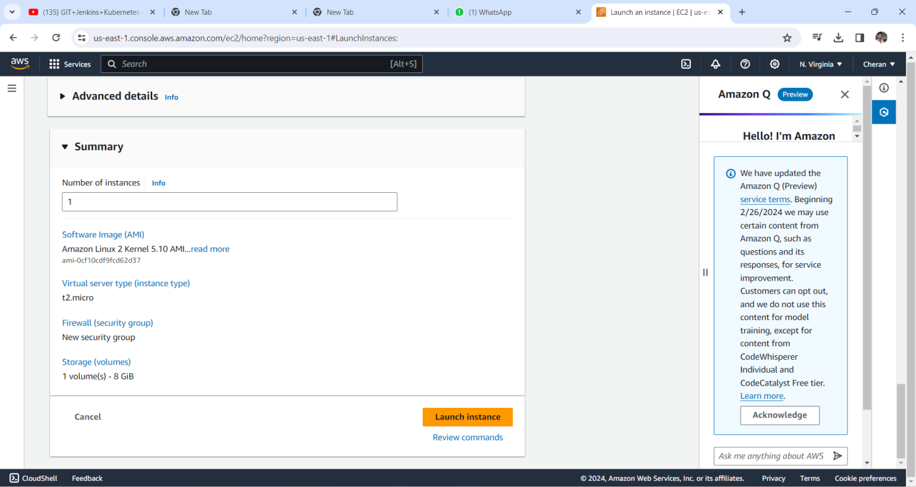
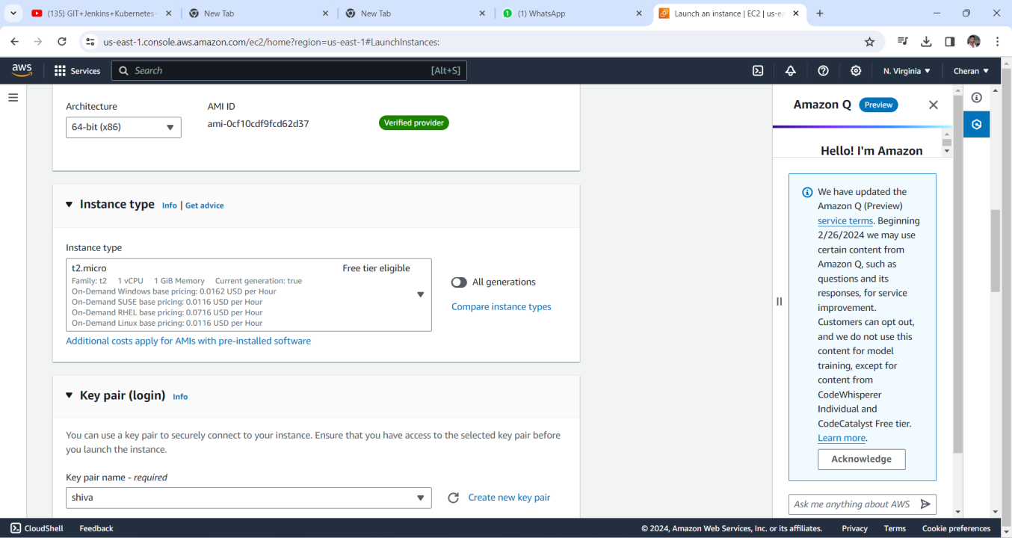

Slide 30
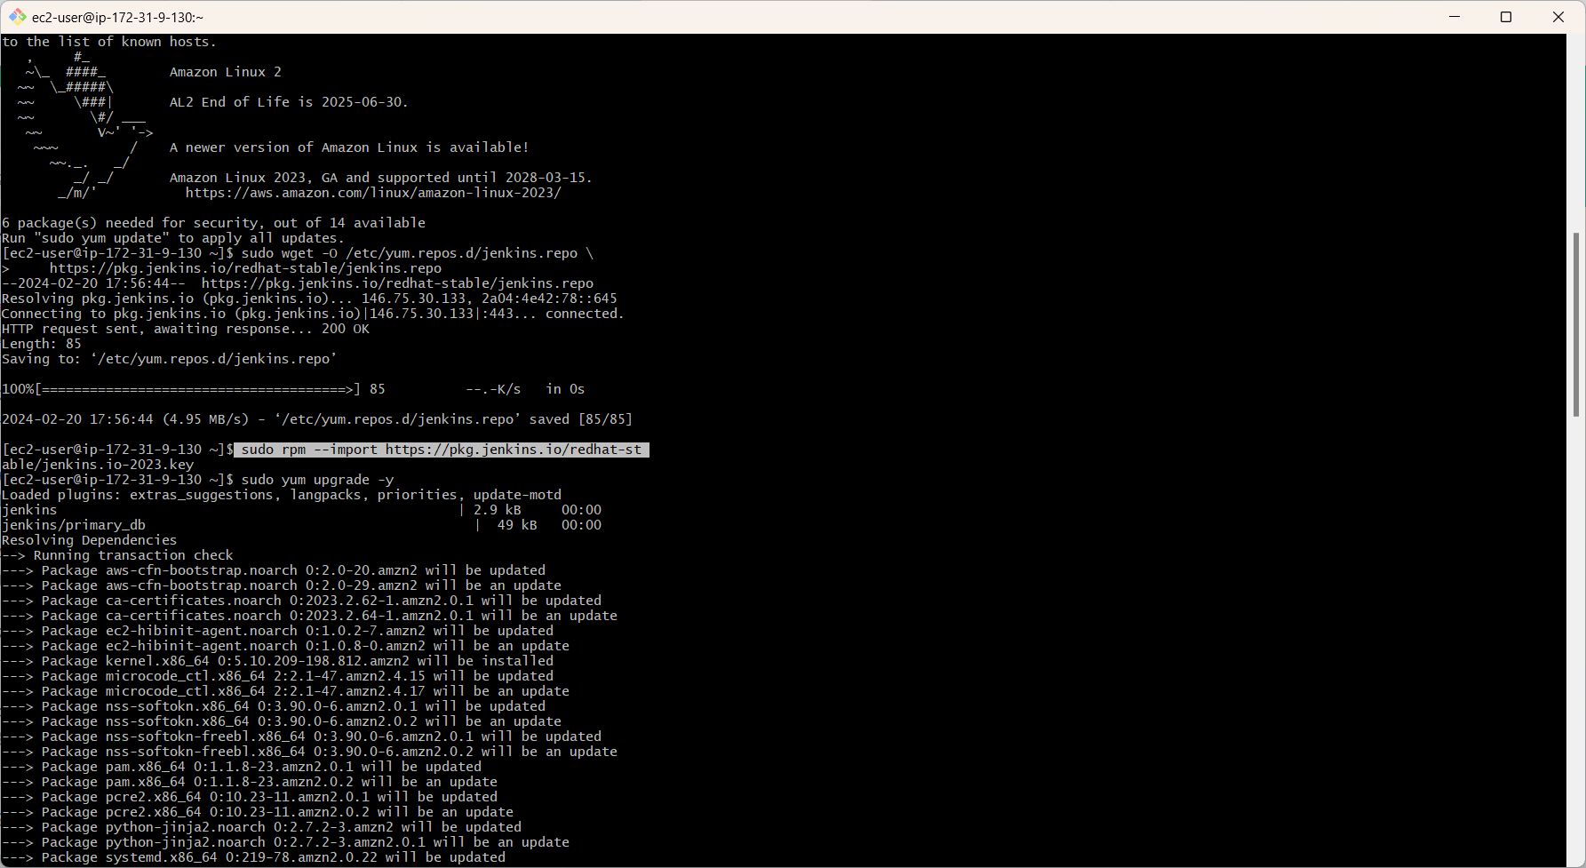
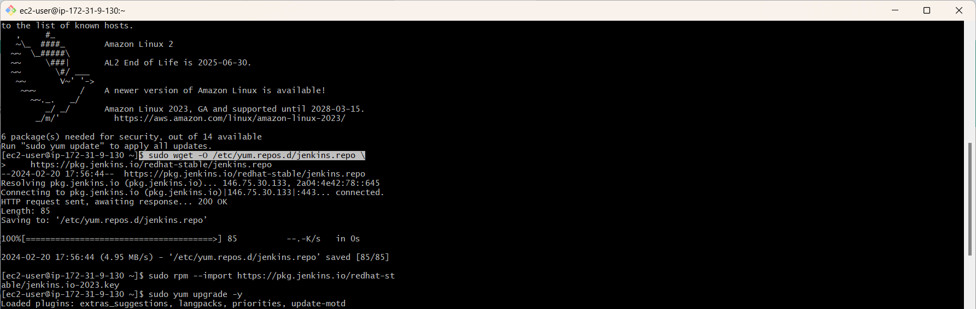
After connect it with terminal install git using command “sudo yum install git –y” install DOCKER using command “sudo yum install docker –y” start and enable docker with commands “sudo systemctl start docker” “sudo systemctl enable docker”

Slide 31
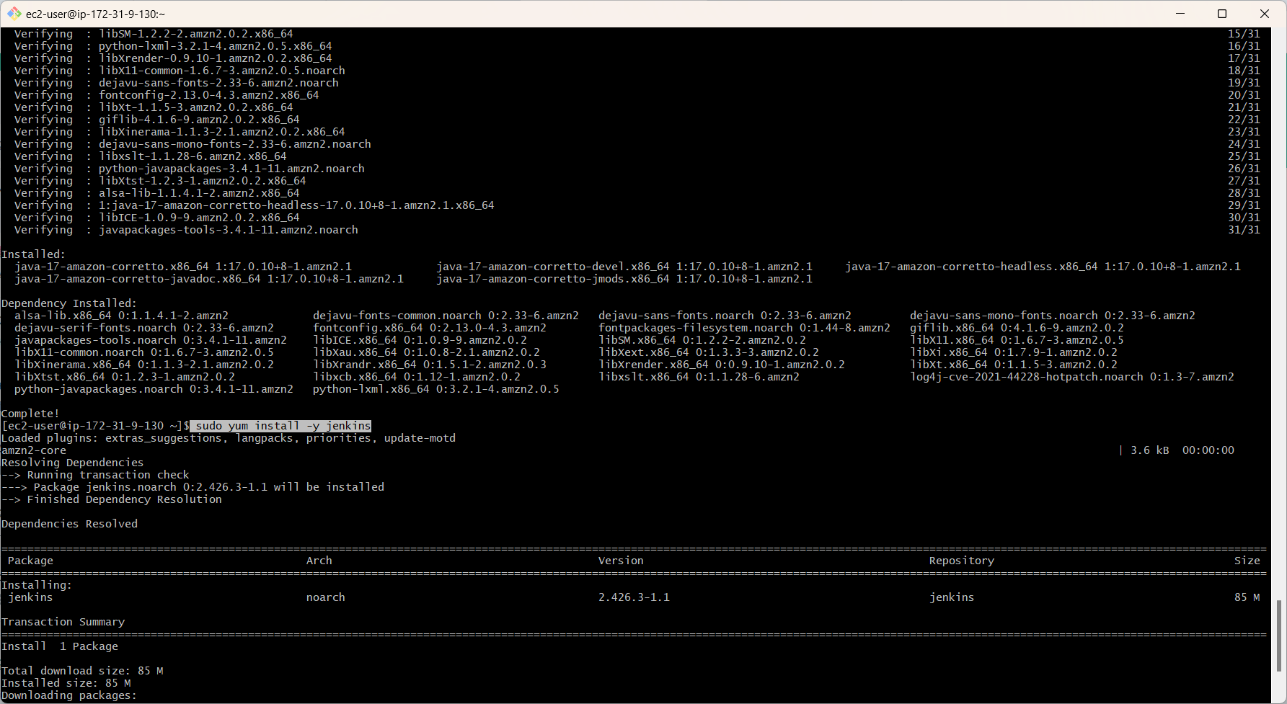

Next we need to install java command is sudo yum install –y java-17* next install jenkins

Slide 32


Create an access key and secret key and check the status of jenkins we will see the administrative password here

Slide 33



Slide 34



Slide 35


We select an free style project next we goto build environment in the excute shell we are given the code docker-compose up -d

Slide 36


Here we can see build now it will buids and clone next browse the public ip of an instance when we browse in the browser you will see the wordpress open

Slide 37

After wordpress login with credentials next install wordpress you can see Welcome to wordpress page

Slide 38
method 6 build and deploy wordpress application using jenkins,git, Github and bashscript
Open aws console management and login with your aws account credentials
In the console goto ec2 service and open that service and llaunch an ec2 instance with t2.micro along with sg port 80, 22 and 8080 and instance name with bashscript

Slide 39


-Sudo wget -O /etc/yum.Repos.D/jenkins.Repo \ https://pkg.Jenkins.Io/redhat-stable/jenkins.Reposudo rpm --import https://pkg.Jenkins.Io/redhat-stable/jenkins.Io-2023.Key -sudo yum upgrade -ysudo yum install -y java-17* -sudo yum install -y jenkins -sudo systemctl start jenkins -sudo systemctl enable jenkins

Slide 40

-Browse the public ip of an instance in the browser -and check jenkins status and copy administrative password to unlock jenkins - give credential details and configuration url

Slide 41


Here you select an item as free tier and login, after login jenkins goto excuteshell in build environmentand give the commands and deploy-job

Slide 42



Slide 43
method 7 build and deploy wordpresss application in pipeline method by using jenkins,git and github tools and apply build triggering
Open an aws console management and login with aws account credentials
In the console home search an ec2 service open it and launch an instance with t2 .micro and sg with port numbers 80,22 and 8080 for jenkins and instance name is pipeline

Slide 44


When you browse the public ip of an instance for jenkins you have given 8080 along with public ip
Notes:
After launch

Slide 45



When you browse the public ip of an instance for jenkins you have given 8080 along with public ip when you browse in newtab

Slide 46


After unlocking jenkins you installed suggested plugins and login with credentials

Slide 47



Slide 48


Select the git in source code management and paste the url in repository url and select branch to build [*/main] and next click on save create an new item and build now open the clone job and build triggers and check the POLL SCM you have given five stars*

Slide 49


Triggering using build periodically
Open the clone job and check configure build periodically and enter [* * * * *] in the schedule

Slide 50


Here we can see up stream project as clone-job and downstream project as build-job

Slide 51

Triggering using git webhooks
.To create webhook open GITHUB repo and click on repo settings
. Click on WEBHOOK and ADD WEBHOOK
.paste the URL of jenkins along with / github-webhook at the end
.in content select an application/json type and add

Slide 52


.Here we can see webhook is created successfully
.After this first clone-job built and build-job built after clone job
.after build two jobs next browse the public ip of an instance we see wordpress open

Slide 53




Slide 54


Method 8 build and deploy wordpress application by using terrafrm
PROCEDURE
Open an aws console management and login with aws account details
select an instance as amazon linux 2
Launch an instance with t2.medium and port with 22 ,80 and

Slide 55


Connect the instance with terminal

Slide 56


After connect with terminal we need to install terraform with commands
. sudo yum install -y yum-utils
. sudo yum-config-manager --add-repo https://rpm.releases.hashicorp.com/AmazonLinux/hashicorp.repo
.sudo yum -y install terraform

Slide 57


Creating terraform completely
.You have given AWS CONFIGURE and create ACCESS KEY and SECRET KEY
.Now write the scripts and create files in terraform and executes the scripts with terraform commands
Terraform Init
Terraform Validate
Terraform Fmt
Terraform Plan
Terraform Apply

Slide 58


Here we can see 7 resources created
Next browse the public ip of an instance and you have seen the wordpress page open

Slide 59


Here login with credentials as we given information
Click on install wordpress
Login with username and password

Slide 60


Slide 61




vpc
subnets
rtb
igw

Slide 62

Method 9 build and deploy wordpress application by using jenkins, git,github,and terraform
Open an AWS console management and login with aws account details
Search ec2 and click on it and launch an instance with t2.micro and port 22 ,80
launch an instance

Slide 63



Slide 64


In advance settings sections in userdata we have have given scripts for for install
Java
Jenkins
Git
Terraform

Slide 65


Here you can see installing all commands
sudo wget -O /etc/yum.repos.d/jenkins.repo \ https://pkg.jenkins.io/redhat-stable/jenkins.reposudo rpm --import https://pkg.jenkins.io/redhat-stable/jenkins.io-2023.key
sudo yum upgrade –y
sudo yum install -y java-17*
sudo yum install -y jenkins
sudo systemctl start jenkins
sudo systemctl enable jenkins

Slide 66



Slide 67



Slide 68



Slide 69


Goto the GITHUB and copy the URL and paste the url in source code management in repository URL it has terraform files
In build environment use secret text/file
Here we have to given ACCESS_KEY and SECRET_KEY so we create it in IAM rolres

Slide 70


Now ACCESS_KEY and SECRET_KEY are created
In the SECRET TEXT we have given variables and credentials
now add credentials for giving SECRET_KEY

Slide 71


In build steps in EXCUTESHELL you have given commands for creating resources
Terraform init
Terraform validate
Terraform plan
Terraform apply --auto-approve

Slide 72


When we click on build now it will build successfully
And we seen console output FINISHED : SUCCESS
Now copy the public ip of an instance and browse it the wordpress opens

Slide 73



Slide 74


Slide 75


Slide 76



Slide 77



Slide 78


Slide 79
Method 11 deploying wordpress application using jenkins,git & terraform with build triggers
.-Open an AWS console and login with AWS acoount credentials
.In the console search for an ec2 service and click on it and open
.launch an instance with t2.micro and select an amazon linux 2 along with sg add rules for port 22, 80 and 8080
And click on launch instance it will be created

Slide 82

Now connect the instance with terminal
After connected it with terminal next you check the status of jenkins
Active running and give the ADMINISTRATIVE PASSWORD for unlock JENKINS

Slide 86
Clone the GITHUB repo where the TERRAFORM scripts are stored .
In the SOURCE CODE MANAGEMENT give the branch */MAIN

Slide 87
In the BUILD ENVIRONMENT select the secret text and give the variables as ACCESS_KEY and SECRET_KEY

Slide 88


Slide 89

Build step select an EXECUTE SHELL enter TERRAFORM commands for resources created
Give all the configurations and click on save
Deploy-job is created successfully

Slide 90

triggering build periodically
Select buld triggers and select build periodaically
And set the schedule is [H/15 * * * * *]
Wait for sometime the job is started building

Slide 91
After resources created and finished success
Next copy the public ip of an created instance and browse it browser the wordpress page open

Slide 93

Triggering using poll scm

Slide 95

Copy the public ip of an created instance and browse it in the browser
You can see the wordpress page open and login with credentials next click on install wordpress

Slide 96


Slide 97

Triggering using webhooks

Slide 98

.open GITHUB repository settings click on WEBHOOKS and ADD WEBHOOKS

Slide 99

In the PAYLOAD URL paste the url of jenkins
And select content type as application/json

Slide 100


Slide 101

Here we can see webhooks created successfully
It given http along with public ip browse the public of an instance wordpress page launch

Slide 102




Slide 103


Resources created for triggering using poll scm, build periodically and webhook

Slide 104



Slide 105



Slide 107


Slide 108


